Slide 1
An Experimental Approach to Replication Performance Optimization in PostgreSQL…
BALAJI VENKAT
IITM Pravartak Technologies Foundation

Slide 2
Objective:
Incorporate multicast to optimize Replication in PostgreSQL

Slide 3
The Use Case
Postgres has not evolved beyond primitive TCP communication in replication
Leads to low limits on the number of replicas that can be supported

Slide 4
Problem Statement
AWS RDS related :
You can create up to 15 read replicas from one source DB instance within the same Region.
https://docs.aws.amazon.com/AmazonRDS/latest/UserGuide/USER_PostgreSQL.Replication.ReadReplicas.html
Azure database related :
You can replicate from the primary server to up to five replicas.
https://learn.microsoft.com/en-us/azure/postgresql/flexible-server/concepts-read-replicas

Slide 5
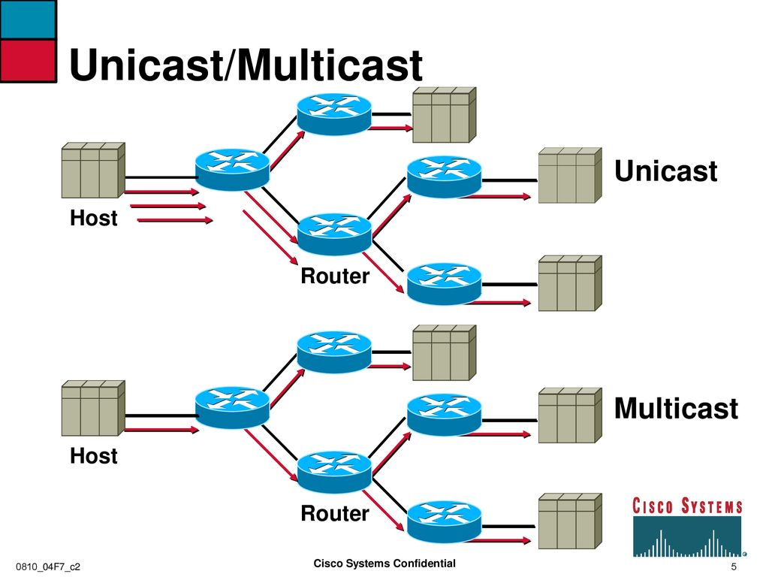
TCP versus Multicast
A
B
C
D
E

Slide 6
Background of the Idea
Reducing overhead and network bandwidth along with latency…
Use PIM (Protocol Independent Multicast) BIDIR (Bidirectional) multicast for replica management in PostgreSQL.
This mechanism is used in the internet today for applications such as Distributed collaboration, Financial applications, Real-time group communication and more.
Helps to efficiently stream changes from a primary server to multiple standby replicas thereby:
Reducing TCP overhead and
Reducing network bandwidth requirements which is highly optimized in the multicast approach.
Reducing Latency

Slide 8
Required PostgreSQL changes
Multicast Support in Streaming Replication:
Create a multicast module to push changes to multicast tree
The module would act as a "multicast sender" to the shared multicast group.
Replicas (the "multicast receivers") would need custom configurations to join the multicast group and apply the received WAL entries.
An efficient error recovery mechanism would need to be implemented.

Slide 9
Consistency and Conflict Resolution
Consistency: A form of negative acknowledgment mechanism & checksum validation may be necessary to ensure that all replicas are in sync. Designated Local Repairer as in Pragmatic General Multicast need to be deployed
Sequence numbers and other helper items need to be incorporated in the multicast stream. A NAK for a given sequence number is handled in the primary if not done at the Designated Local Repairer level.
Conflict Resolution: If two replicas get out of sync (e.g., due to missed data), an external mechanism might be needed to resynchronize them. To pull missing WAL data, Herein Designated Local Repairer as in Pragmatic General Multicast may apply.

Slide 10
Handling Primary and Replica Failures
Failover Management: In the event of a failover, the new primary should be able to continue with the same multicast group to ensure other replicas can remain on the same replication stream communication.
Re-synchronization: In the case of replica failure, re-synchronizing them with the primary via multicast might involve a recovery mechanism that allows the replica to "catch up" with missing WAL entries from the primary.

Slide 11
Advantages
Instead of 1-to-1 TCP connections, the replication is done through multicast with appropriate latency and bandwidth optimizations.
Postgres buffer utilization on primary is optimized.
Higher number of replicas could be supported.
Seamless transfer of primary to secondary without changes to multicast group.
The addition of Designated Local Repairer is used to save packets from falling through the cracks in the multicast tree. Primary as fallback for DLR.

Slide 12
Challenges
PostgreSQL Modifications: Since PostgreSQL does not natively support PIM-BIDIR multicast for replication, one would have to develop the module that uses multicast replication.
Network Complexity: Setting up PIM-BIDIR multicast routing requires network routers and switches that support multicast. Suitable devices and their respective configurations may need to be deployed.
Data Integrity: Ensuring data integrity and consistency across replicas when using multicast could be more challenging than traditional streaming replication.

Slide 13
Conclusion
This is an innovative approach that could offer high-bandwidth efficiency for large-scale PostgreSQL replication setups.
Requires a customization to PostgreSQL’s replication mechanism, network setup, and administration tools to ensure data consistency, error handling, and security.

Slide 14
Thank You! Questions?
References:
PIM BIDIR specification:
https://datatracker.ietf.org/doc/html/rfc5015

