Slide 1
PostgreSQL 17's Login Event Triggers : A Developer's Toolkit for Enhanced Security
Bharath Kumar Chethan Gangadharaiah
Delivery Consultant Delivery Consultant

Slide 2
Agenda
Login Event trigger
Key Considerations
Recovering from a Broken Login trigger
Use Cases
Best Practices
Q/A

Slide 3
Login Event Trigger
Event triggers – Triggers that happen when an event occurs
Previously, ddl_command_start, ddl_command_end, sql_drop,
table_rewrite
Now! Login Event
Fires whenever a user connects
Use Cases
Any error in the trigger will prevent anyone from logging in
Notes:
Logiin event –lot of developers have been waiting for this feature and its committed.
This capability allows developers to execute custom code when users connect to a database, opening up new possibilities for security, auditing, and session management.
Why its important now ? Native integration.
Connection login hooks
Extension
Jobs which poll pg_stat activity
Custom application code
In databases, the login event is the first interaction a user has when connecting, making it an ideal candidate to trigger functionality based on different use cases.
Use cases:
logging user logins, for verifying the connection
initialize session settings
dynamically assign roles based on connection time or other factors.
for some personalization of environment.
5 global temp tables

Slide 4
Login Event Trigger
How They Differ from Other PostgreSQL Triggers
2) Timing in the Connection Process
Execution Scope
Timing
Event Type
After Authentication
Before Session initialization
Notes:
Execution Scope: While regular triggers are associated with specific tables and fire on DML operations (INSERT, UPDATE, DELETE), login event triggers operate at the database level and fire on user authentication1415.
Event Type: Login triggers respond to a connection event, whereas other event triggers typically respond to DDL commands like CREATE, ALTER, or DROP8.
Timing: Login triggers fire at the beginning of a user session, before any SQL commands are executed, unlike other triggers that fire during or after specific operations4.
Availability: Login Event Triggers are a new feature in PostgreSQL 17, while other types of triggers have been available in previous versions1.
After authentication: The trigger fires after the user has been successfully authenticated but before the server sends its response to the client4.
Before session initialization: The trigger executes before any user-specific session data or settings are applied17.
Early in the connection: It runs before any user-initiated SQL commands can be executed, allowing for early intervention or setup4.

Slide 5
Login Event Trigger – Work Flow
Notes:
1.In order to prevent the connection time overhead when there are not triggers, the commit introduces pg_database.dathas loginevt flag which indicates databases has active login triggers. Flag is set while creating-create/lter
Dropped- when there are no active triggers
2.Trigger order –Alphabetic
3.Cancelling the connection n psql wont cancel the inprogress trigger

Slide 6
Syntax
Example
Notes:
Two componets are 1.Event trigger function and 2.Event trigger 3. No filtering clause is allowed

Slide 7
Key Considerations
Avoid complex operations
Keep the trigger function lightweight and efficient
Check before DML Operations
Permission to tables
Notes:
1.Security definer
2.Check before DMl operations
3.Permisson to tables
4. Keep the trigger function lightweight and efficient
Avoid complex operations that could delay user connections

Slide 8
Recovering from a Broken Logon Trigger
Single user Mode
Pros
. Allows direct access to fix the trigger
. Doesn’t affect other Database settings
Cons
. Requires database downtime
. May interrupt ongoing operations
Stop
Start in Single User Mode
Disable / Fix the trigger
Restart Normally
Notes:
Stop Server --Use systemctl stop postgresql or pg_ctl stop. Ensure no processes are running.
Start in Single-User Mode-- Use postgres --single -D /path/to/data -U postgres template1. --Must run on server machine; no network access.
Disable Broken Trigger-- Use DROP EVENT TRIGGER trigger_name; after identifying with pg_event_trigger. --Ensure superuser privileges for the user.
Fix the Issue -Edit function, create missing tables, or adjust permissions as needed. --Test logic before recreating trigger.
Restart Normally --Use systemctl start postgresql and verify logins. --Check logs for errors during startup.
1. Use Single-User Mode(stop-start-fix-restart postgres)
Pros:
• Allows direct access to fix the trigger
• Doesn’t affect other database settings
Cons:
• Requires database downtime
• More complex to implement
• May interrupt ongoing operations
Method:

Slide 9
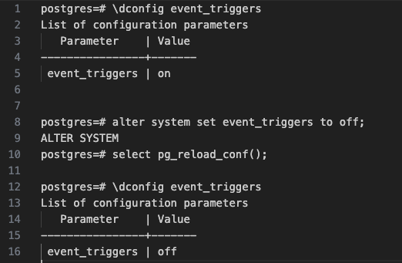
Recovering from a Broken Logon Trigger
2) Configuration Parameter
event_triggers=on/off
Notes:
1.Introduced in pg17 configuration parameter which controls the enablement and disable of event triggers
2.Boolean value
3.Doesn’t require restart.
4. If you are logged in y an

Slide 10
Recovery using configuration parameter
Pros
. Simple and quick to implement
. Doesn’t require Database restart
Cons
. Disables all event triggers
. Requires access to config file
Edit
Postgresql.conf
Reload Configuration
Drop / Fix the trigger
Re-enable Event Triggers & reload configuration
Notes:
Access Server Machine-- Log in to the server via SSH or local access. --Requires system administrator access.
Edit postgresql.conf--Set event_triggers = false in the configuration file.
Reload Configuration-- Use pg_ctl reload -D /path/to/data to apply changes. Ensure server is running and accessible.
Connect as Superuser-- Log in as superuser (e.g., psql -U postgres). Should succeed with triggers disabled.
Fix the Trigger Drop or fix the trigger using SQL commands, recreate if needed. Ensure superuser privileges for modifications.
Re-enable Event Triggers-- Set event_triggers = true in postgresql.conf, reload with pg_ctl reload. Save changes before reloading.
Verify Fix Test logins as regular users to ensure triggers work. Check logs for errors during login attempts.
2. Disable Event Triggers
Pros:
• Simple and quick to implement
• Doesn’t require database restart
• Allows immediate access to fix the trigger
Cons:
• Disables all event triggers, not just the problematic one
• Requires access to server configuration files
alter system set event_triggers to off;

Slide 11
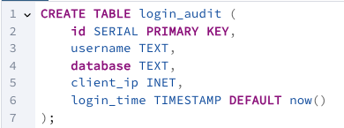
Use Case 1 – Security and Audit Loging
Audit trail of database access
Create an audit table
Create login event trigger
Other options,
log_connections and log_disconnections
Query pg_stat_activity
Notes:
Login triggers can be used to create a audit trail of database access.
As you can see, create simple audit table, create trigger function and create login event trigger
Log essential information such as:
• User who logged in (Username/Login ID)
• Database • IP address of the connection
• Timestamp of the login • Application name used for the connection
• SSL or Non-SSL (pg_stat_activity)
• connection type/backend type (pg_stat_activity)
• Login success or failure
This information which is audit log table can be used in security audits, compliance requirements, and troubleshooting access-related issues.
Other options to audit logging:
Set Log_connection and Log_disconnection config parameter
We can also query pg_stat_activity to check for new logins
Points to remember:
• Implement appropriate data retention policies. For example: 1 year. This will avoid the table from growing very large
• Ensure proper permission on audit log table
• Set up alerts for security events
• Consider partitioning of log table

Slide 12
Use Case 1 – Security and Audit Loging Cont..
Security Audit, Compliance Requirements, Troubleshot Login
Key considerations for Audit table
Data Retention Policy
Secure the table
Alert Security Events
Partitioning (if needed)
Notes:
This information which is audit log table can be used in security audits, compliance requirements, and troubleshooting access-related issues.
Points to remember:
• Implement appropriate data retention policies. For example: 1 year. This will avoid the table from growing very large
• Ensure proper permission on audit log table
• Set up alerts for security events
• Consider partitioning of log table

Slide 13
Use Case 2 – Session/Access Control
Restrict Login based on time
Restrict login if application name not specified
Limit Connections
Block logins from suspicious client
Enforce SSL
Failed login detection
Notes:
Login Event Triggers and be used for Session/Access Control
And Setup Security Enforcement for login to database
Different checks can be done for session control. Some of them are
• Restrict login attempts during specific time windows in a day
• Restrict login of user if application name not specified (current_setting('application_name’))
• Limit the number of concurrent sessions per user. - Restrict login of user if number of active sessions in pg_stat_activity greater than 10 or 5
• Block logins from suspicious IP addresses – based on check IP address pattern or use IP address data type to check for range
• Enforce SSL connection type to connected to the database
Above login rules can be stored into metadata table, and these rules can be checked and Exception can be raised and log the failed login attempt in separate table
• Failed login detection – Store the failed logins in separate table failed_login_attemps. Check if there are failed login attempts in last 5 mins for specific ip address or username and restrict login

Slide 14
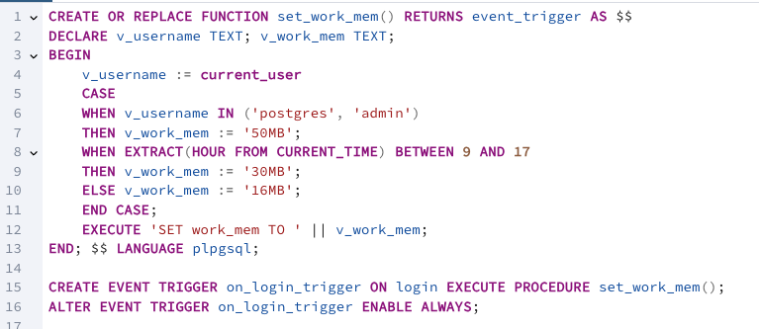
Use Case 3 – Dynamic Resource Management
Set custom configuration parameters
User/Time/Application/Role based session variable configuration
Notes:
Login triggers can be used for Session Initialization and Dynamic Resource Management
…. This lets user to set up the session environment
Set custom configuration parameters
Adjusting work_mem, maintainance_work_mem, max_parallel_workers_per_gather, temp_buffers etc. based on time of day or server load
1) User base session variable configuration
Setting user-specific session level variables like time zone (locale setting), statement timeout , lock timeout etc.
2) Time based session variable configuration
3) Application name based session variable configuration
4) Role based session variable configuration
Set search_path based on role
Set work_mem based on role
Set statement time out, lock time out based on role
• Session variables can be stored in metadata table and set in the login trigger

Slide 15
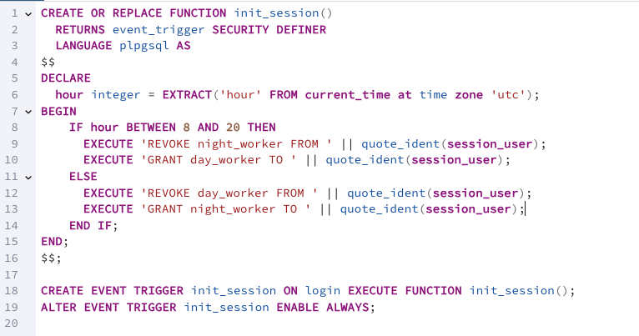
Use Case 4 – Dynamic Role Assignment
Login triggers enable dynamic role assignment based on various factors:
• Time of day: Assign different roles for day and night shifts
• User attributes: Grant specific roles based on user metadata • Connection properties: Adjust permissions based on application name
Notes:
Dynamic Role Assignment Login triggers enable dynamic role assignment based on various factors: • Time of day: Assign different roles for day and night shifts • User attributes: Grant specific roles based on user metadata • Connection properties: Adjust permissions based on the connecting application For example, you could implement a trigger that assigns a “day_worker” role during business hours and a “night_worker” role outside of those hours, ensuring appropriate access levels.

Slide 16
Other use cases
Recording connection patterns
Tracking resource usage
Identifying potential security issues
Initializing temporary tables
Notes:
Recording connection patterns
Tracking resource usage in the database
Identifying potential security issues
Initializing temporary tables - Create temporary tables for session-specific data

Slide 17
Best Practices
Keep login triggers lightweight to avoid connection delays
Test thoroughly as these triggers affect all database connections
Handle exceptions appropriately
Document the triggers well as they can affect system-wide behavior
Consider performance implications, especially for high-traffic databases

Slide 18
References
Database Login event trigger
Logon trigger in PostgreSQL
A Developer’s Guide to New Features
Notes:
PostgreSQL 17’s Login Event Triggers provide powerful new ways to control and manage database connections. By incorporating these triggers, developers can enforce policies, enhance security, and streamline connection workflows effectively.

Slide 19
Credits
Icons used in this presentation are provided by Flaticon.
Authentication icons created by Pixelmeetup – Flaticon
Session icons created by xnimrodx - Flaticon

Slide 21
ProServe Database Day
November 2024

