Slide 1
Postgres load balancing is secretly broken: The cancellation problem
Jelte Fennema-Nio
Principal Software Engineer @ Microsoft Maintainer of Citus & PgBouncer
Contributing to Postgres semi-regularly @JelteF
2023-02-29

Slide 2
What am I going to talk about?
Load balancing across Postgres servers
Read replicas
Citus
Low level details about cancelling queries
PgBouncer

Slide 3
What is load balancing?
Sharing workload across servers
Different servers handle independent requests

Slide 4
Why load balancing for Postgres?
Scaling reads and/or writes

Slide 5
But why???
Queries
Postgres
Clients

Slide 6
Postgres needs help!!!

Slide 7
Read replicas help to scale read traffic
Client
Client
Clients
Read queries
Write queries
Postgres
Primary
(read/write)
Postgres read replicas
(read-only)
Copy written data

Slide 8
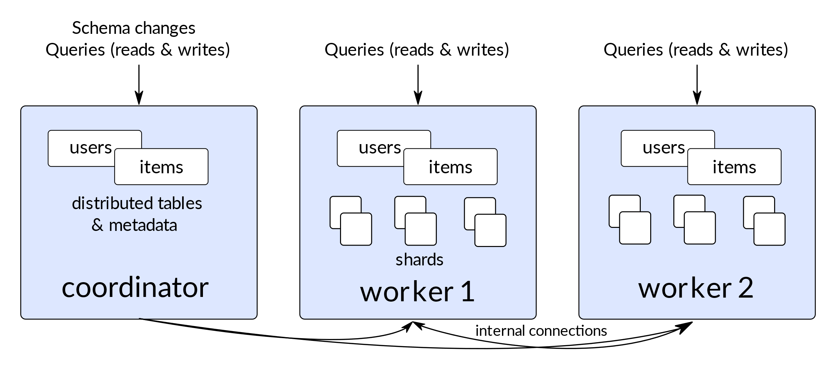
With Citus you can even scale writes

Slide 9
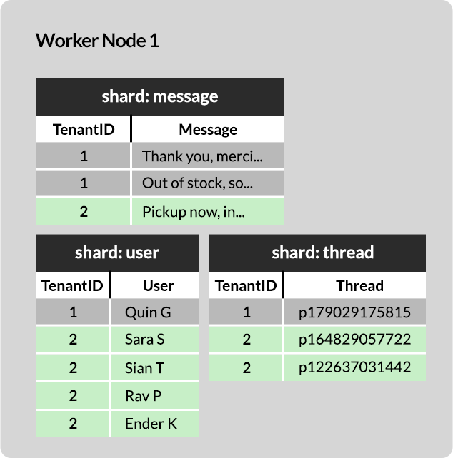
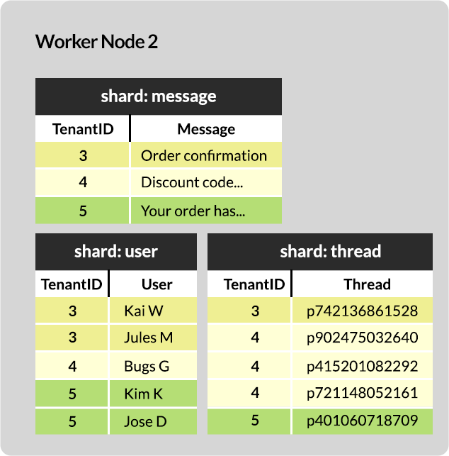
Row-based sharding with Citus

Slide 10
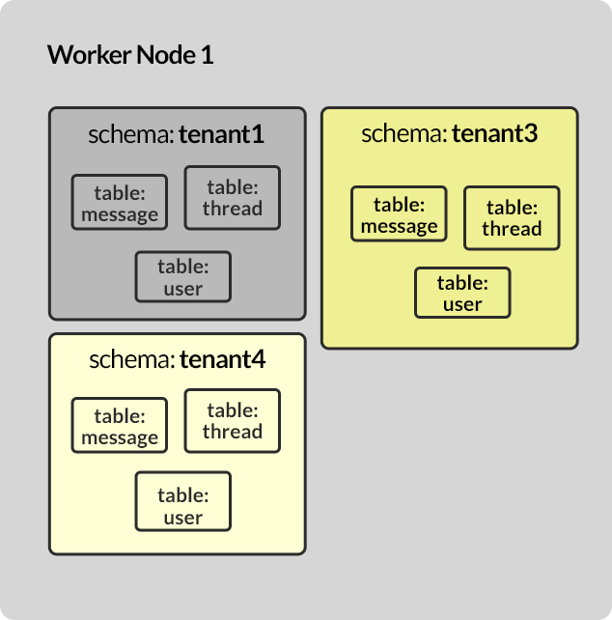
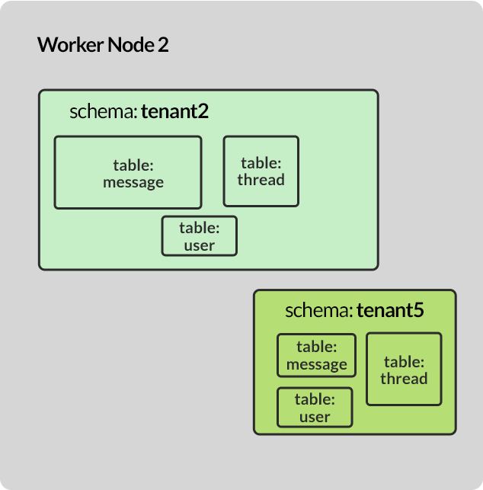
Schema-based sharding with Citus

Slide 11
Traffic needs to be spread

Slide 12
How to do load balancing?
Option 1: Client-side load balancing
Option 2: Server-side load balancing

Slide 13
Clients know about all servers and choose different ones

Slide 14
Client-side load balancing: problem 1
Every client needs logic to choose a server

Slide 15
Client-side load balancing: client support
Many client libraries support it:
JDBC (Java)
Npgsql (C#)
rust-postgres (Rust)
any libpq based client since PG16 (I contributed this)
But many others don’t:
github.com/lib/pq (Go)
Asyncpg (Python)

Slide 16
Client-side load balancing: problem 2
Every client needs to know about all the servers

Slide 17
Client-side load balancing: server discovery
Option 1: Hardcoded list of IPs or domains used by client
Option 2: Multiple DNS records for the same domain, one for each server

Slide 18
Client-side load balancing: problem 3
Cache invalidation… What happens when you add a server?

Slide 19
How to do load balancing?
Option 1: Client-side load balancing
Option 2: Server-side load balancing

Slide 20
One server is “secretly” many servers

Slide 21
Server-side load balancing: How it works
Off-the-shelf TCP load balancer
Software defined networking (SDN)
Each TCP stream is assigned a different server

Slide 22
Server-side load balancing: Problems
Costs money…
When not using SDN it introduces extra latency

Slide 23
So why use it at all?

Slide 24
Does not require users to listen to the DBA or cloud vendor!!!!

Slide 25
Let’s order that loadbalancer!!!

Slide 26
Not so fast…
Important assumption: Different TCP streams are independent

Slide 27
How Postgres cancellation requests work
Client
-> CONNECT
<- You can send me
SECRET-TOKEN-123 to cancel
any queries on this connection
CANCEL SECRET-TOKEN-123
-> RUN:
DELETE FROM users;
<- CANCELLED QUERY
Postgres Server

Slide 28
So what happens with cancellations and a load balancer
Client
DELETE FROM users;
CANCEL SECRET-TOKEN-123
Load balancer
DELETE FROM users;
I don’t know SECRET-TOKEN-123. This is probably a hacker.
Let’s ignore this request
CANCEL SECRET-TOKEN-123
Postgres Server A
Postgres Server B

Slide 29
Not so fast (continued)
Important assumption: Different TCP streams are independent
Correct: Query on same Postgres session == same TCP stream
Correct: New session == new TCP stream
Wrong: Query cancellation request == new TCP stream

Slide 30
The cancellation problem
Query cancellations end up at the wrong server most of the time
Workaround: Trigger cancellations multiple time at the client side
But can we think of a solution?

Slide 31
Idea: Make Postgres servers know about each other
Client
DELETE FROM users;
CANCEL SECRET-TOKEN-123
Load balancer
I don’t know SECRET-TOKEN-123
This was probably meant for another server. Let me ask Server A
DELETE FROM users;
CANCEL SECRET-TOKEN-123
<- CANCELLED QUERY
Postgres Server A
Postgres Server B

Slide 32
How to make this idea work?
Postgres does not support this out of the box
What can we do to make it work?

Slide 33
Idea 1: Postgres extension
No extension hooks exist for cancellation related code ☹
Getting hooks (or built-in functionality) in Postgres will take a long time and won’t work on old Postgres versions
Need to build cancellation forwarding support

Slide 34
Idea 2: Modify PgBouncer

Slide 35
But wait what is PgBouncer...
SELECT …
PgBouncer
SELECT …
Postgres
Client
DELETE …
DELETE …

Slide 36
Idea 2: Modify PgBouncer
PgBouncer can run in front of any Postgres server version
PgBouncer already has cancellation forwarding code to forward cancellations to Postgres
“Just” needs to be modified to send cancellation to other PgBouncer servers instead of Postgres
This is what I did

Slide 37
Option 2: Modify PgBouncer
Client
DELETE FROM users;
CANCEL SECRET-TOKEN-123
Load balancer
DELETE FROM users;
I don’t know SECRET-TOKEN-123
This was probably meant for another server. Let me ask Server A
CANCEL SECRET-TOKEN-123
<- CANCELLED QUERY
Postgres Server A
Postgres Server B
Postgres A
PgBouncer A
PgBouncer B
Postgres B

Slide 38
Making PgBouncer scale
Single-threaded design becomes bottleneck

Slide 39
Making PgBouncer scale
Multi-process with so_reuseport=1
No more “port already in-use”
The Linux kernel becomes a load balancer

Slide 40
We end up with a multi-layered load balancer
Client
DELETE FROM users;
CANCEL SECRET-TOKEN-123
Load balancer
<- CANCELLED QUERY
Postgres Server A
Postgres Server B
Linux kernel
Linux kernel
PgBouncer A1
PgBouncer A2
PgBouncer B1
PgBouncer B2
Postgres A
Postgres B

Slide 41
The final problem
To which one should PgBouncer forward it?
Sending the cancellation to all servers is quite heavy

Slide 42
The final solution
Encode an identifier in the cancellation token: e.g. SECRET-TOKEN-123-A1
I implemented this and it’s called peering
Configured using peer_id config and [peers] section: https://www.pgbouncer.org/config.html#section-peers

Slide 43
Problem solved!

Slide 44
Or so I thought….

Slide 45
PgBouncer isn’t a fully perfect proxy
Missing prepared statement support was a major problem
Workaround was using the slower session pooling mode

Slide 46
Wait... what are prepared statements???
Improves performance when you send the same query often

Slide 47
Without prepared statements
RunQuery: SELECT ... WHERE id=1
RunQuery: SELECT ... WHERE id=2
RunQuery: SELECT ... WHERE id=3
RunQuery: SELECT ... WHERE id=99
Parsing & planning is done every time

Slide 48
With prepared statements
Prepare: MyAwesomeQuery = SELECT ... WHERE id = $1
Execute: MyAwesomeQuery(1)
Execute: MyAwesomeQuery(2)
Execute: MyAwesomeQuery(3)
Execute: MyAwesomeQuery(99)
Parsed and planned only once in Prepare

Slide 49
Why is this difficult with transaction pooling?
ERROR: P1 does not exist
Exec: P1
Prepare:
P1 = SELECT
Exec: P1
C1: P1 = SELECT
Client
Prepare:
P1 = SELECT
PgBouncer
Postgres
Prepare:
P1 = UPDATE
Client
Prepare:
P1 = UPDATE
ERROR: P1 already exists

Slide 50
So how did we make prepared statements work?
C1: P1 = SELECT = SP1
C1: SP1 = SELECT
C2: SP1 = SELECT
Exec: P1
C2: P1 = UPDATE = SP2
C1: SP2 = UPDATE
Prepare:
P1 = SELECT
Exec: SP1
SUCCESS
Client
Prepare:
SP1 = SELECT
PgBouncer
Postgres
Prepare:
SP2 = UPDATE
Client
Prepare:
P1 = UPDATE
SUCCESS

Slide 51
How to enable?
max_prepared_statements = 100 (or some other non-zero number)

Slide 52
Is that all?

Slide 53
Sadly no…
Still some things don’t work with PgBouncer (yet)
Logical replication connections
All configuration parameters as connection options
Some TLS certificate auth setups
Some LDAP auth setups
If there’s more please talk to me…

Slide 54
Any questions?

Slide 55
Got 2 minutes?
We’d love your input
on how you use Postgres
Get your FREE socks @ Microsoft booth

