Slide 1
Real-time Data Processing with Go and PostgreSQL
Darshan from IndiaMART

Slide 2
Golang
Concurrency Model
Memory Safe(GC)
Strong Standard Library
Growing Community
Faster Development

Slide 3
Importance of Real-Time Data Processing
Decision making
Customer experience
Challenges in Real-time Data Processing
Keeping latency Low
Infrastructure Management
Consistency

Slide 4
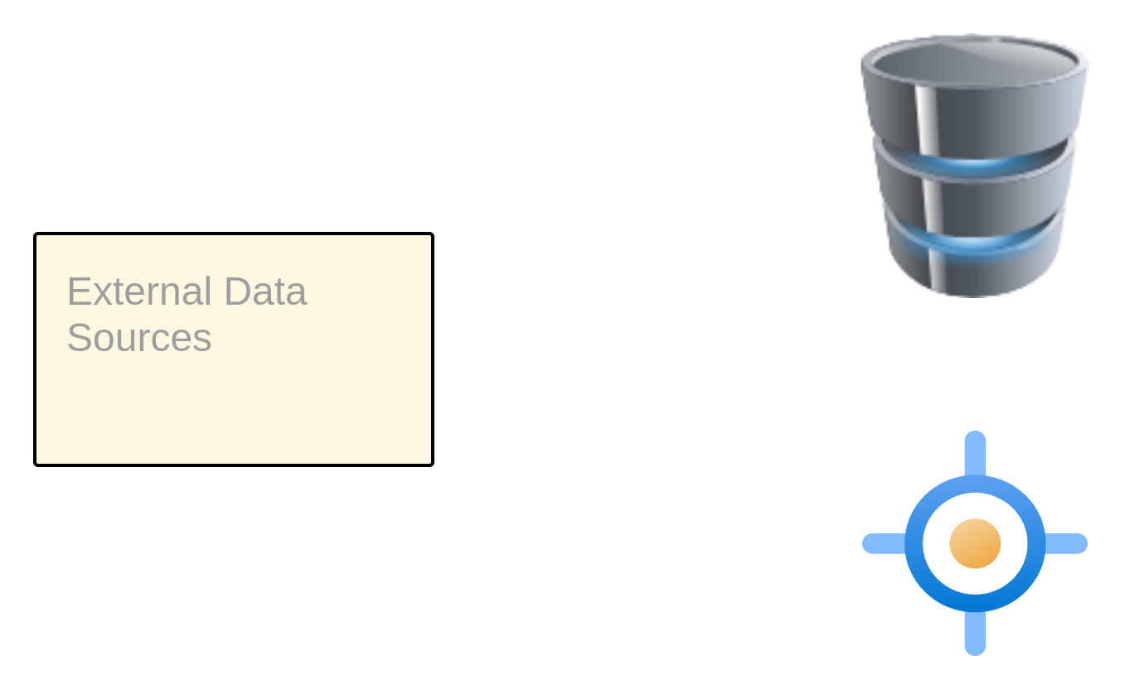
Solutions
Independent
Downstream (Change Data Capture, pub/sub)
Independent Streaming
DB
Target

Slide 5
Downstream
CDC/pubsub
DB
Target
Change Data Capture(CDC)
Log , Trigger , Query etc
Pub/Sub Mechanism
Channel with Publisher and Subscriber

Slide 6
Log Based CDC:
Connector
Queue
Target
DB
WAL files
Passing to Queues
Consumers

Slide 7
Trigger Based CDC:
Function execution
Stage Table
Downstream processes
Query Based CDC:
1
3
2
DB
Target

Slide 8
Pub/Sub Mechanism
Pub
Sub
Channel
DB
Process
Publish change
Queued in memory
Subscribers Consume

Slide 9
DEMO

Slide 10
Q&A
Thank you

