Slide 1
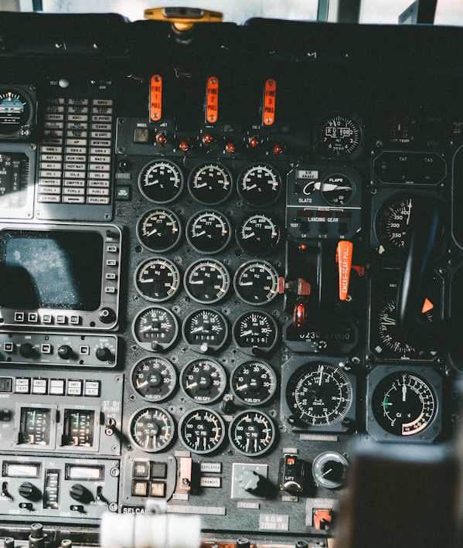
🎛 Postgres Monitoring
A Practical Peek Under the Hood
Rohan Kumar​
Site Reliability Engineer​
@rohankmr414 on the internet​

Slide 2
out of the box solutions don't work everytime

Slide 3
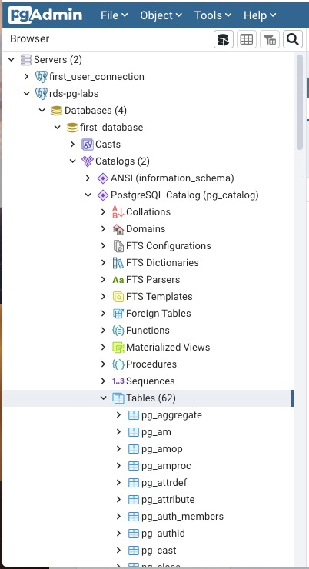
The PostgreSQL Catalog
PostgreSQL stores the metadata information about the database and cluster in the schema ‘pg_catalog’. This information is partially used by PostgreSQL itself to keep track of things itself, but it also is presented so external people / processes can understand the inside of the databases too.

Slide 4
What are we looking for in our monitoring solution?
Stats from pg_catalog as some sort of metrics
Actionable alerts
on the metrics
A way to visualize
the metrics

Slide 5
how many of you are familiar
with prometheus?
🙋🏻🙋🏻🙋🏻

Slide 6
Prometheus
An open-source monitoring system with a dimensional data model, flexible query language, efficient time series database and modern alerting approach.
api_http_requests_total{method="POST", handler="/messages"} 420​
Also supports alerting natively!

Slide 7
postgres_exporter
github.com/prometheus-community/postgres_exporter

Slide 8
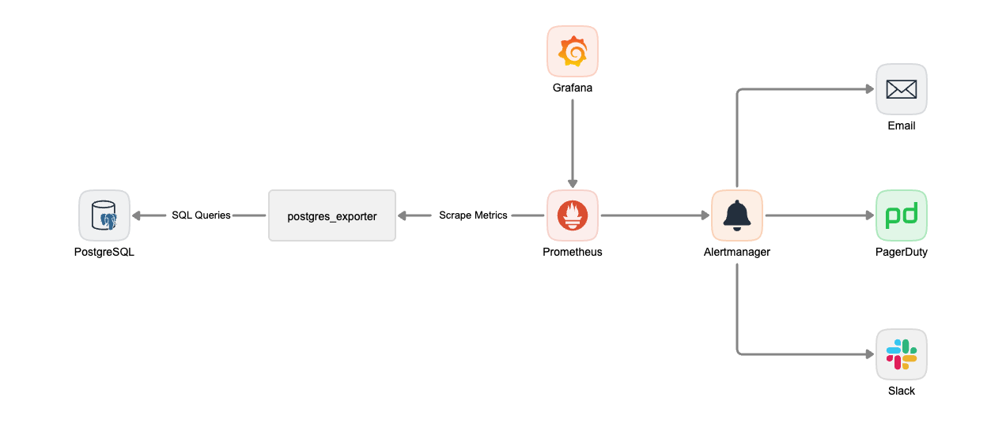

Slide 9
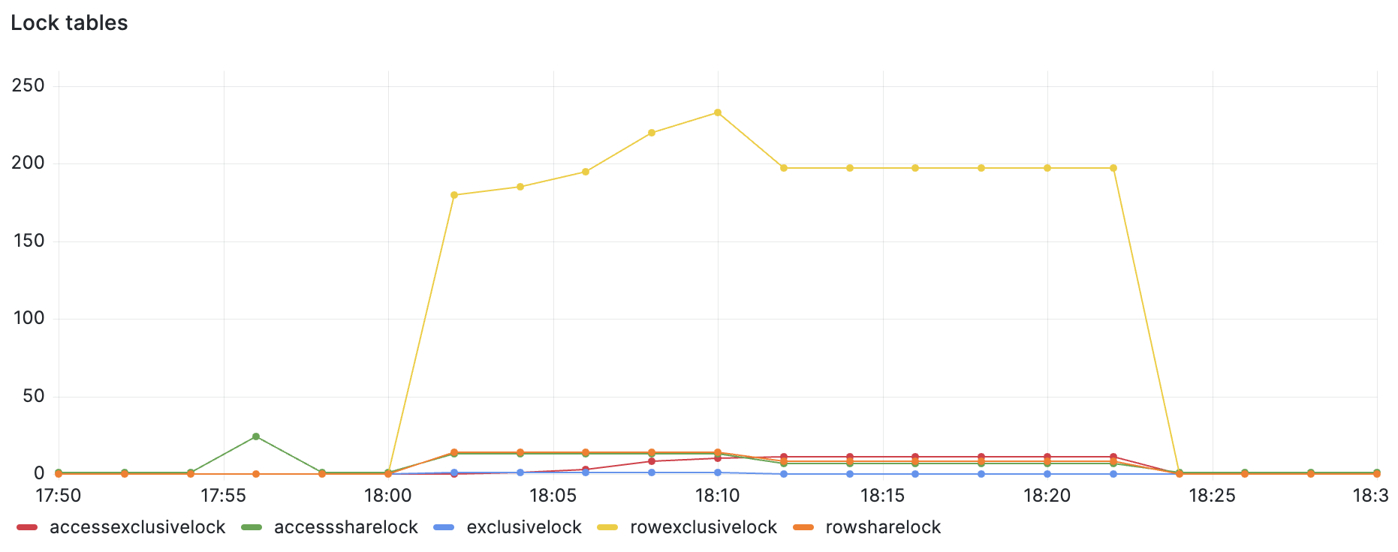
Number of locks
pg_locks_count

Slide 10
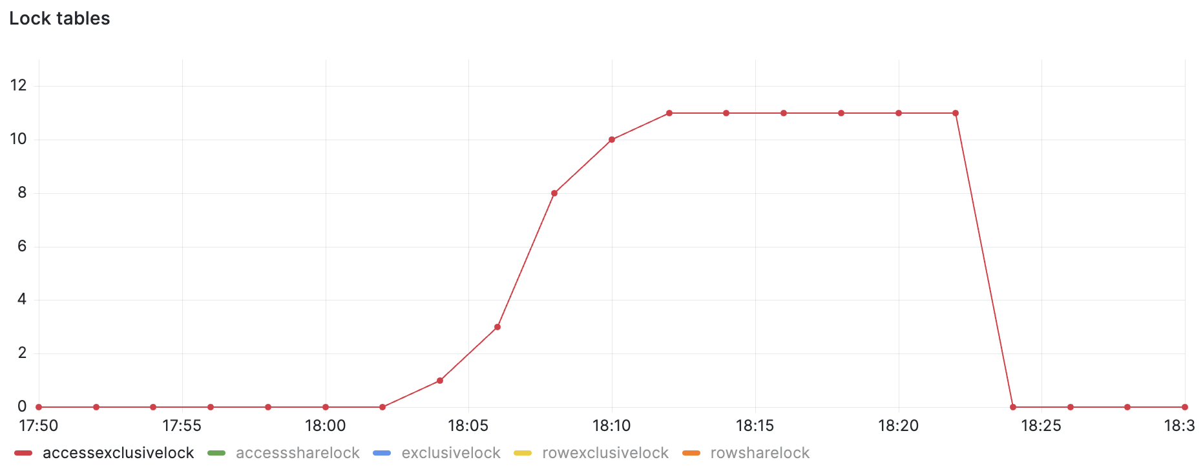
Number of accessexclusivelock
pg_locks_count{mode="accessexclusivelock"}

Slide 11
Rate of tuples inserted per table per second
sum(rate(pg_stat_user_tables_n_tup_ins[2m])) by (schemaname, relname)

Slide 12
- alert: PostgresqlAccessExclusiveLockAcquired
expr: pg_locks_count{mode="accessexclusivelock"} > 1
for: 2m
labels:
severity: critical
annotations:
summary: Postgresql too many accessexclusivelock acquired
description: "Too many accessexclusivelock acquired on the database."

Slide 13
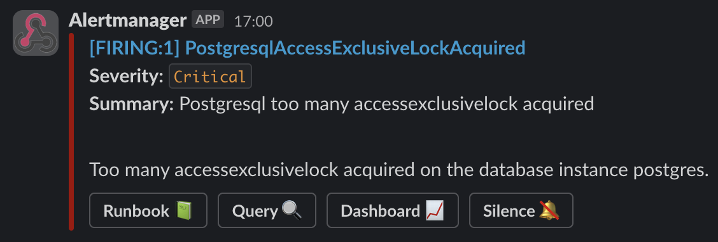

Slide 14
Query to list down all the indexes with their scan count and size
SELECT
tablename,
t.schemaname as schemaname,
indexrelname,
idx_scan,
pg_relation_size (
quote_ident (t.schemaname) || '.' || quote_ident (indexrelname)
) as size_bytes
FROM
pg_tables t
INNER JOIN pg_stat_user_indexes i ON t.tablename = i.relname
and t.schemaname = i.schemaname;

Slide 15
schemaname | tablename | indexrelname | idx_scan | size_bytes
public | users | users_pkey | 314999 | 368640
public | books | books_pkey | 37 | 294912
public | shops | shops_key | 61514 | 360448

Slide 16
pg_indexes:
query: |
SELECT
tablename,
t.schemaname as schemaname,
indexrelname,
idx_scan,
pg_relation_size(
quote_ident(t.schemaname) || '.' || quote_ident(indexrelname)
) as size_bytes
FROM
pg_tables t
INNER JOIN pg_stat_user_indexes i ON t.tablename = i.relname
and t.schemaname = i.schemaname;
metrics:
- tablename:
usage: "LABEL"
description: "Name of the table"
- schemaname:
usage: "LABEL"
description: "Name of the schema that this table is in"
- indexrelname:
usage: "LABEL"
description: "Name of the index"
- idx_scan:
usage: "COUNTER"
description: "Number of index scans initiated on this index"
- size_bytes:
usage: "GAUGE"
description: "Disk space used by the index"

Slide 17
pg_indexes_idx_scan{schemaname="public", tablename="users", indexrelname="users_pkey"} 1.23Bil
pg_indexes_size_bytes{schemaname="public", tablename="users", indexrelname="users_pkey"} 745K

Slide 18
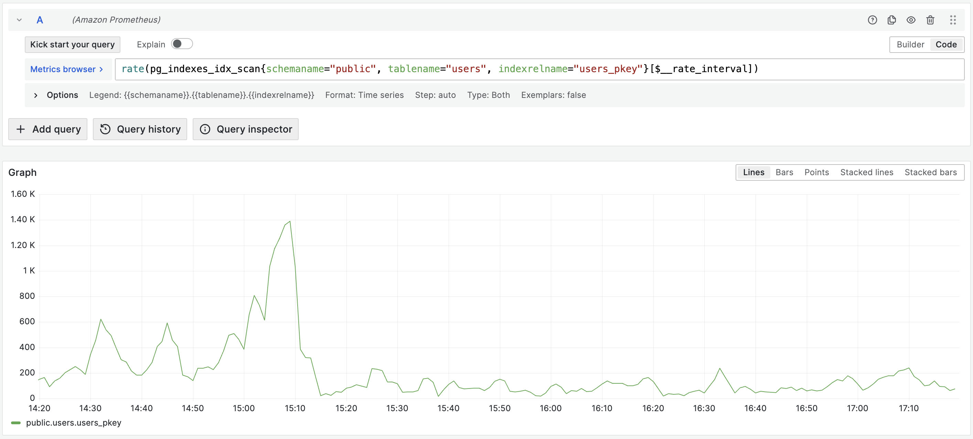

Slide 19
auto_explain
auto_explain is a PostgreSQL extension that allows you to log the query plans for queries slower than a (configurable) threshold.
# postgresql.conf
shared_preload_libraries = 'auto_explain'
auto_explain.log_min_duration = '100ms'

Slide 20
SELECT count(*)
FROM pg_class, pg_index
WHERE oid = indrelid AND indisunique;
This produces log output similar to the following in the PostgreSQL log file in the tserver/logs directory
LOG: duration: 316.556 ms plan:
Query Text: SELECT count(*)
FROM pg_class, pg_index
WHERE oid = indrelid AND indisunique;
Aggregate (cost=216.39..216.40 rows=1 width=8) (actual time=316.489..316.489 rows=1 loops=1)
-> Nested Loop (cost=0.00..213.89 rows=1000 width=0) (actual time=10.828..316.200 rows=110 loops=1)
-> Seq Scan on pg_index (cost=0.00..100.00 rows=1000 width=4) (actual time=7.465..8.068 rows=110 loops=1)
Remote Filter: indisunique
-> Index Scan using pg_class_oid_index on pg_class (cost=0.00..0.11 rows=1 width=4) (actual time=2.673..2.673 rows=1 loops=110)
Index Cond: (oid = pg_index.indrelid)

Slide 21
Question?
Thank You

