Slide 1
PostgreSQL Unboxed: Leveraging Containerization for Scalable Database Deployments
Shalaka Dengale - D&A Consultant, AWS Ramya Bhat - D&A Consultant, AWS

Slide 2
Introduction
db3
db1
db2
Monolithic
Application
Monolithic
Database
Micro services
Micro Database
Notes:
-There was a retail client which had thrived on its robust monolith architecture.
-Complex system with interconnected modules, tightly coupled and challenging to maintain.
-as the demands of their customers grew more sophisticated and the market landscape evolved, they realized that they needed a more agile and scalable solution.
-They began breaking down their monolithic application into smaller, independently deployable services. Each service was designed to handle a specific business function, such as inventory management, order processing, or customer relations.
-the importance of decoupling their database from the application logic.
-They chose PostgreSQL as their preferred database due to its robust features and open-source nature. However, deploying and managing PostgreSQL instances across their growing fleet of microservices posed a significant challenge.
-Traditional methods of setting up dedicated database servers seemed daunting and costly, especially considering the dynamic nature of their development environment.

Slide 3
What is a Container?
Container
App 1
App 2
App 3
Bins/Libs
Bins/Libs
Bins/Libs
Container Runtime Engine
Host OS
Server (Host)
Notes:
Ask what is picture? Imagine you have a big kitchen (physical server) and want to prepare different dishes (applications).
Traditional Virtualization:
You build separate tiny kitchens (virtual machines) inside the big one, each with its own stove (operating system), pots and pans (software), and ingredients (data).
Each tiny kitchen functions independently, but they all take up space and resources in the big kitchen.
Containerization:
You use standardized containers (containers) in the big kitchen, each holding the ingredients and utensils (application and its dependencies) needed for a specific recipe.
All the containers share the big kitchen's stove (host operating system), making them much lighter and faster to deploy.
Key Differences:
Resource Usage: Containers are lightweight and share the OS, while VMs are heavier and have their own OS, making containers more efficient.
Isolation: Both provide isolation, but containers share the kernel, offering tighter integration and faster startup.
Portability: Containers are easier to move between environments due to their standardized format.
Startup Time: Containers start up much faster than VMs due to their lighter weight.
Think of it as:
VMs: Like building separate apartments in a house (more isolated, resource-intensive).
Containers: Like using standardized food trucks (portable, efficient, share resources).
Both have their uses, but containerization is often the preferred choice for modern, agile development and deployment.
Traditional Virtualization:
You build separate tiny kitchens (virtual machines) inside the big one, each with its own stove (operating system), pots and pans (software), and ingredients (data).
Each tiny kitchen functions independently, but they all take up space and resources in the big kitchen.
Containerization:
You use standardized containers (containers) in the big kitchen, each holding the ingredients and utensils (application and its dependencies) needed for a specific recipe.
All the containers share the big kitchen's stove (host operating system), making them much lighter and faster to deploy.
Add animation and ask question: How many of you have worked on containers?

Slide 4
PostgreSQL In a Container
Client
Postgres
Container Registry
Container Runtime
Container
PostgreSQL
Image
Pull PostgreSQL container image
PostgreSQL
Image
Connect to Postgres DB
Load container image into container runtime
Postgres, PostgreSQL and the Logo are trademarks or registered trademarks
of the PostgreSQL Community Association of Canada, and used with their permission.

Slide 5
Replication of PostgreSQL Database In Container
PG_BASEBACKUP
Replica
PGDATA
Read only
PGDATA
Primary
PG_BASEBACKUP
Replica
PGDATA
Read/Write
Read only
PG_BASEBACKUP
Replica
PGDATA
Read only

Slide 6
Docker Demo

Slide 7
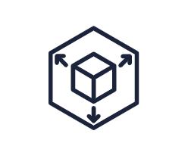
Challenges for managing containerized databases at scale
Limited Orchestration
Manual Scaling
No Self-Healing
Notes:
Limited orchestration: Docker Compose offers basic orchestration capabilities, but it's not designed for complex deployments with many containers and services.
Single node management: Docker primarily manages containers on a single node, making it unsuitable for distributed deployments.
No self-healing: If a container fails, you need to manually restart it. You may loose the data incase it goes don.

Slide 8
How would you solve this?

Slide 9
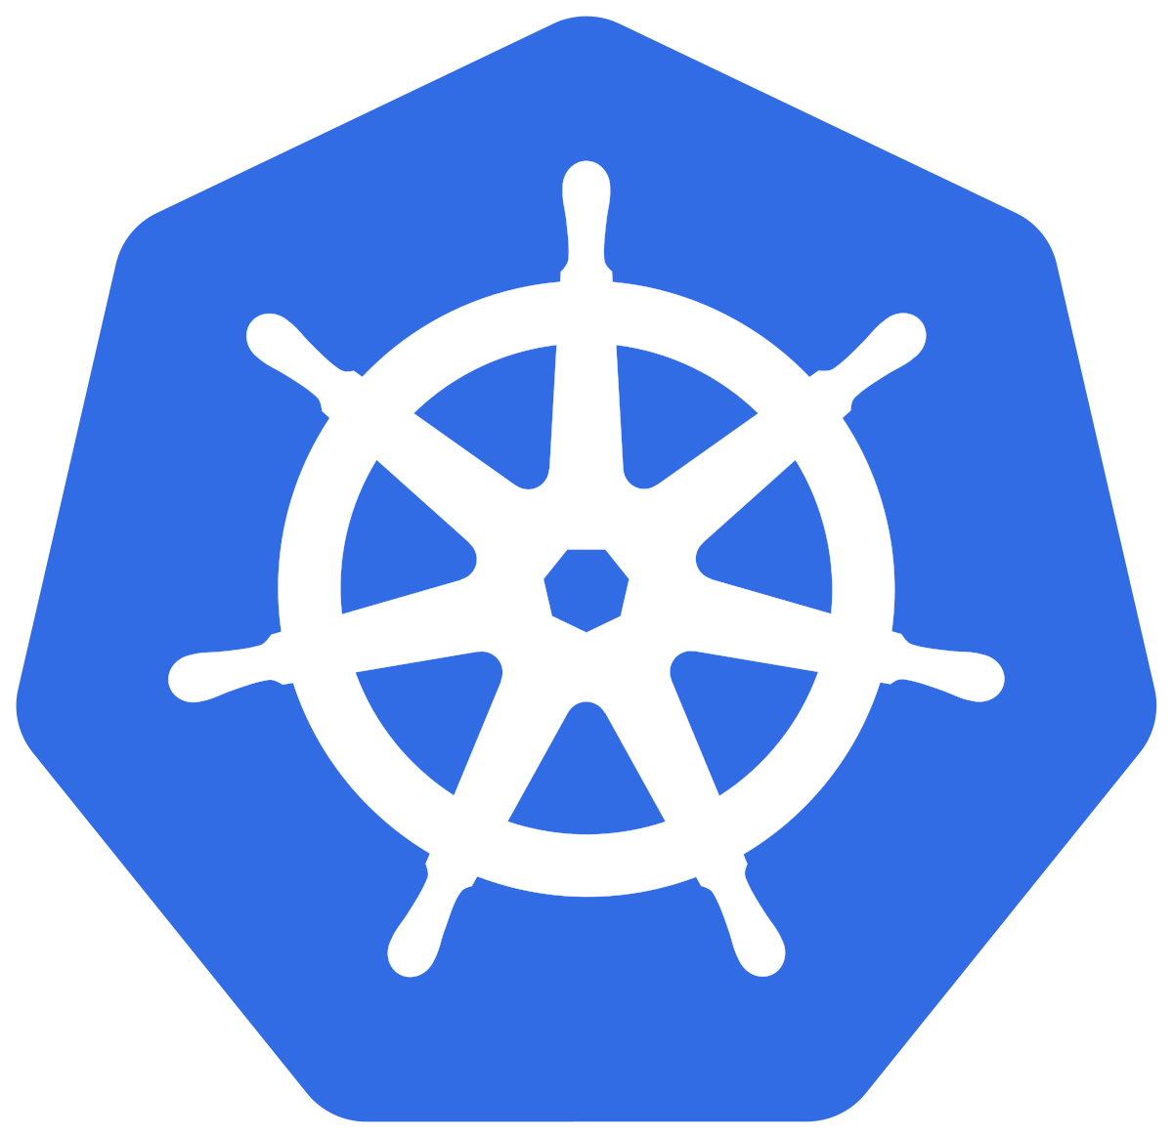
What is Kubernetes?
Open source container orchestration tool.
Helps manage containerized applications
in different deployment environments.
Enables auto-scaling for deployments.
Recovers automatically from failures.

Slide 10
Kubernetes Components
Network
ConfigMap
External Configuration of your application.
StatefulSets
Manage deployment and Pods scaling
For stateful apps or Databases
Service:
Permanent IP address
Lifecycle of Pod and Service not connected.
ConfigMaps
Service
Persistent Volumes
Storage for pod.
Exists beyond lifecycle of a Pod.
StatefulSets
Pod-0
Pod-1
Pod-2
❌
Vol
vol
vol
Notes:
-Pod – collection of one or more containers, smallest unit of Kubernetes application
Configmap- Database URL is usually in the built in application
Configmap holds the url of the database and other urls.
When db url changes, you just adjust it in the configmap.Config Map is for non-confidential data only.
PV: Physical storage attached , eg local machine or cloud storage

Slide 11
Operators in Kubernetes
Postgres Operators are operators specifically designed to automate the management and deployment of PostgreSQL databases within a Kubernetes cluster.
Opensource Postgres Operators
Crunchy Postgres Operator
Zalando Postgres Operator
CloudNativePG
Movetokube/postgres-operator
Notes:
CrunchyData Postgres Operator (PGO): Offers a comprehensive solution with high availability, disaster recovery, and monitoring.
Zalando Postgres Operator: Employs Patroni for high availability and simplifies integration with CI/CD pipelines.
CloudNativePG: Focused on native streaming replication and designed for Kubernetes-native management.
movetokube/postgres-operator

Slide 12
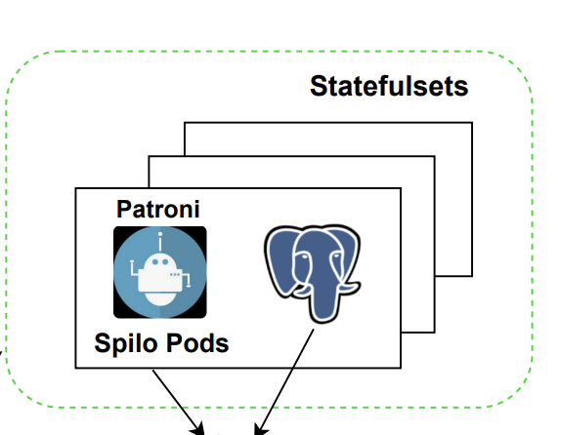
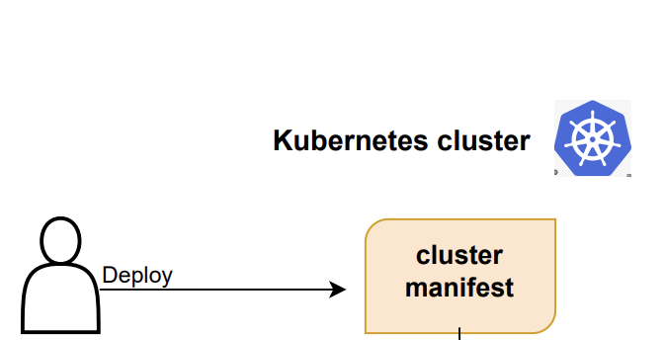
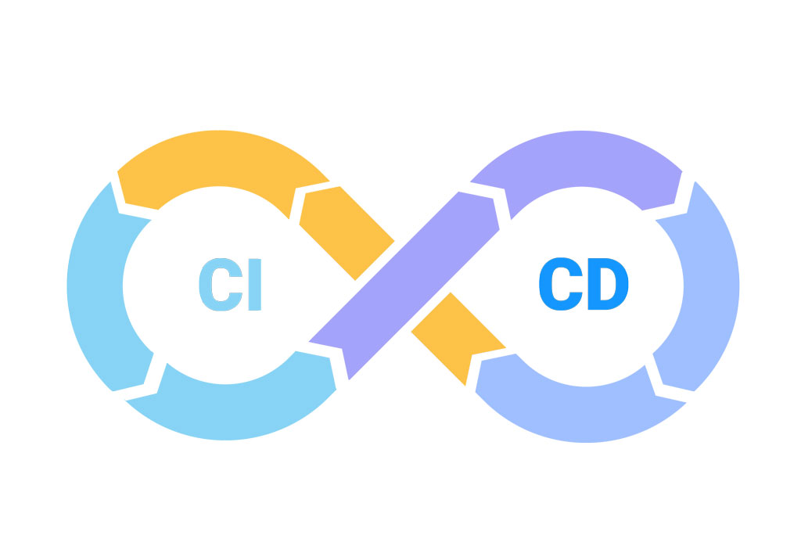
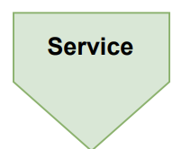
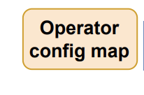
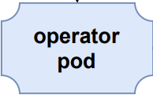
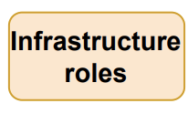
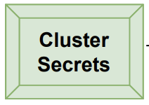
Managing PostgreSQL on Kubernetes with Operators
Patroni
Notes:
Animation
See on patroni if its available on all

Slide 14
Managing PostgreSQL on Kubernetes

Slide 15
Conclusion
Consistency
Scalability
Automation
& DevOps
Resource Efficiency

