Slide 1


VMware Tanzu Greenplum
Product Roadmap
GreenPlum + PostGIS & H3
Rakesh Sharma
Shwetha C Ravoor
Venkatesh Raghavan
Jan
February 2024
Broadcom Proprietary and Confidential. Copyright © 2023 Broadcom. All Rights Reserved. The term “Broadcom” refers to Broadcom Inc. and/or its subsidiaries.

Slide 2
Agenda
About GreenPlum
GIS
Architecture of GreenPlum
Capabilities of GreenPlum
Uber H3
PostGIS

Slide 3










Two Decades of Greenplum History
2003
2013 Pivotal Launched
6.0 Released 2019
Cutting Edge On-Prem
Greenplum Reference Architecture Launched
2010
Purchased by
EMC
4.0 Released
2015
Open Source Greenplum Released w/ Apache License
GPORCA Optimizer GA
Pivotal joins Vmware
Greenplum release | Based on
Greenplum 4.x | Postgres 8.2.15
Greenplum 5.x | Postgres 8.3.23
Greenplum 6.x | Postgres 9.4.24
Greenplum 7.x | Postgres 12.4
5.0 Released 2017 Cloud Offerings
Notes:
Evolving with the market ; dependable for close to 2 decaded

Slide 4


How Do You Build a Highly Scalable EDW?
Scale up option is constrained by resource limitations
?
1 GB
10 GB
100 GB
1 TB

Slide 5
How Do You Build a Highly Scalable EDW?
Scale Out To The Rescue
1 TB
1 TB
1 TB
1 TB
1 TB
1 TB
1 TB
1 TB

Slide 6


Greenplum – Postgres At Scale
Massively Parallel Processing
Enhanced PostgreSQL
Building on top of the world-famous PostgreSQL relational database engine, Greenplum technology innovation brings ANSI standard SQL and OLAP at petabyte scale to the world of PostgreSQL.
Massively Parallel Shared Nothing Database
Combine hundreds of servers, VMs or containers, each with its own dedicated storage connected on a high-speed network to achieve unprecedented performance.
Enhanced Functionality For Big Data Analytics
Added a lot of features to process diverse data types and perform advanced analytics at scale. Terabytes to petabytes, unstructured, structured, semi-structured data, BI to AI analytics – Greenplum can handle it all.
SQL
Master
Host
Standby
Master
Interconnect
node1
node2
node3
nodeN
Segment Host
Segment Instance
Segment Instance
Segment Instance
Segment Instance
Segment Host
Segment Instance
Segment Instance
Segment Instance
Segment Instance
Segment Host
Segment Instance
Segment Instance
Segment Instance
Segment Instance
Segment Host
Segment Instance
Segment Instance
Segment Instance
Segment Instance
Segment Host
Segment Instance
Segment Instance
Segment Instance
Segment Instance
…
Notes:
The shared nothing is implemented at Segment instance level.

Slide 7
Greenplum Architecture
Master, Segment & Interconnect – The Core Components of Greenplum
query
Master coordinates work with Segment Hosts
Master Host
Standby Host
Network Interconnect
High speed interconnect for continuous pipelining of data processing
Segment Host
Segment Instance
Segment Instance
Segment Instance
Segment Instance
Segment Host
Segment Instance
Segment Instance
Segment Instance
Segment Instance
Segment Host
Segment Instance
Segment Instance
Segment Instance
Segment Instance
Segment Host
Segment Instance
Segment Instance
Segment Instance
Segment Instance
Segment Host with one or more Segment Instances
Segment Instances process queries in parallel
Segment Hosts have their own CPU, disk and memory (shared nothing)
Master Hosts
Interconnect
Segment Hosts
Entry point to system
Database listener process
Handles all user connections
Creates query plans
Management and administration tools
Contains no user data
Greenplum Database connection layer
Process coordination and management
Tuple rehashing and shipping
10Gb/25Gb Network Infrastructure
Private LAN configuration
Each contains a portion of user data
Each has its own CPU, disk and memory (shared nothing)
Not accessed directly by users
All client connections enter through the Master
Database listener process listens for connections from Master
Notes:
The Greenplum considers network availability also while deciding the plan to retrieve data

Slide 8



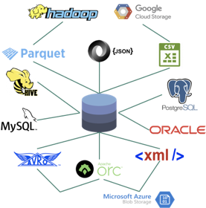




















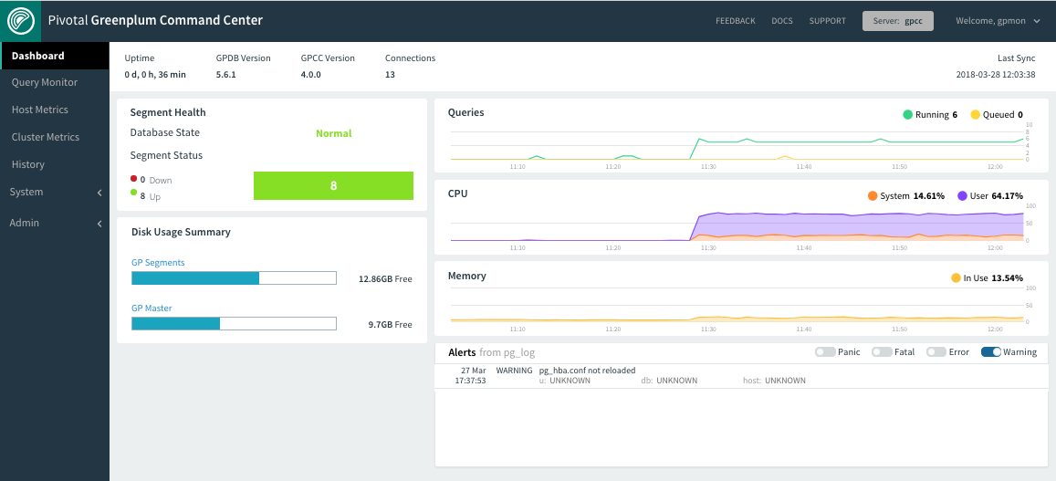


Greenplum : A scalable MPP Postgres with Extra Features
Standard Data Warehouse Features
Open Extra Features
Entreprise Extra Features
BI/Analytics
100 %SQL
Python/R/
Java/Perl/C functions
Machine/
Deep Learning
Federated query processing
Streaming Data Engine
Enterprise Search Platform
Traditional
Row Oriented
Columnar
Structured /
Semi-Structured
Time Series
Multi-Platform Software
Advanced Compression
Image Recognition/OCR
100% Postgres
Super Fast Data Querying and Loading
Scalable Massive Compute Grid
Graph
GeoSpatial
Optimised Connectors
Advanced
Monitoring
Notes:
GreenPlum can handle all of these workloads: Traditional BI , Analytics , Geospatial , Machine Learning , Text Analytics …. And process them with the power of a scale out MPP system
Key Points: SQL/Relational, Postgres , Software, OpenSource, MPP, Shared Nothing, Scale Out

Slide 9












And, Greenplum can Do All These on Any Infrastructure
Infrastructure Agnostic Analytics Platform
Operating System
Containers
Google
Container Engine
Other Kubernetes
(on VMs or not)
Bare-Metal
Infrastructure
Data Center
Private Data Center

Slide 10
Geographic Information System (GIS)

Slide 11

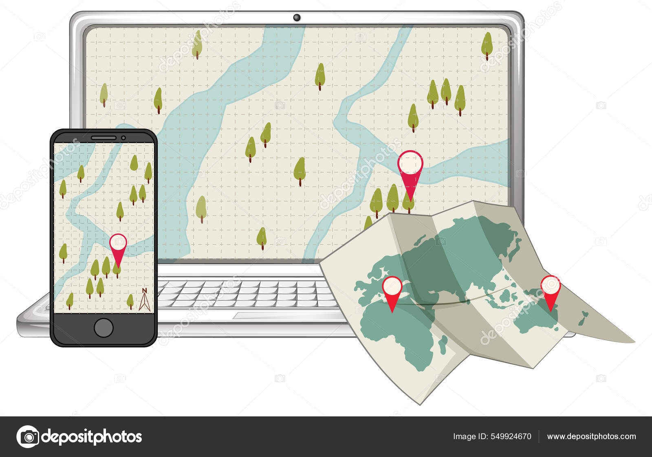
The Map
Computer Map
Map

Slide 12
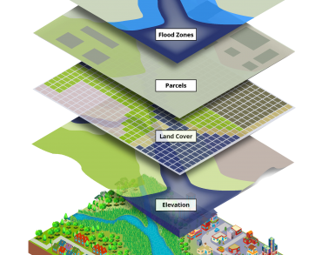
Why do we need GIS? (Geographic Information System)
Everything that exists or occurs does so in time and space.
Knowing and understanding
  Locations
  Spatial patterns
  Spatial trends
GIS the one of the tool to support decision making.
Notes:
Use case of GIS:
Pinpointing new store locations
Analyzing crime patterns
Forecasting and predicting weather
Routing in-car navigation

Slide 13
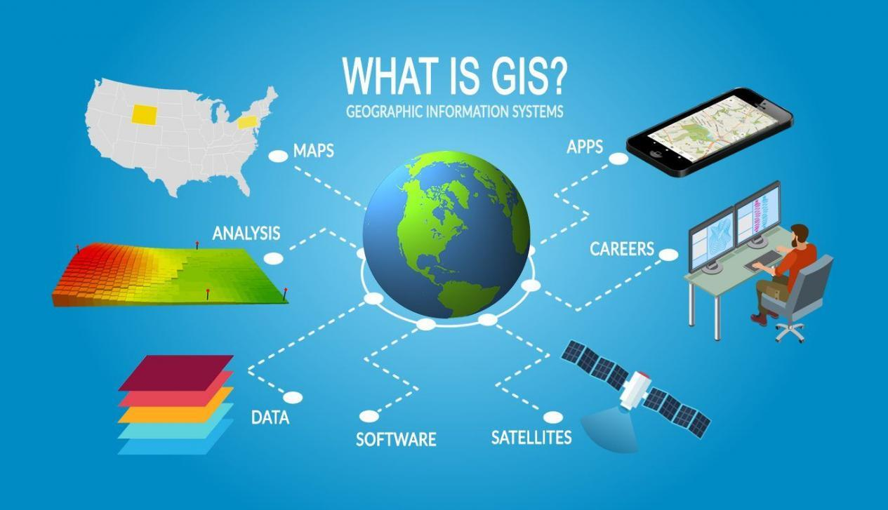
What is GIS? (Geographic Information System)
GIS stores, analyze, and visualize data for geographic positions on Earth’s surface.
Basic Idea behind GIS was:
  Create geographic data.
  Manage it in a database.
  Analyze and find patterns
  Display it on map
Spatial data
  Vector Data: Represented by points, lines, and polygons. features such as cities, roads, and boundaries.
  Raster Data: Represented as a grid of cells, raster data is used to portray continuous phenomena like elevation or satellite imagery.

Slide 14

Why do we need spatial database
Growing Volume of Geospatial Data
  The increasing availability of geospatial data from various sources, including satellites, sensors, and user-generated content, poses challenges in efficiently managing and analyzing large volumes of information.
Complexity of Spatial Relationships
  Spatial relationships between features on the Earth's surface are often intricate. Traditional databases may struggle to handle the complexity of spatial queries and analyses.
Interdisciplinary Applications:
  The interdisciplinary nature of GIS applications, spanning fields such as urban planning, environmental science, logistics, and more, requires a versatile and specialized geospatial database system.
Notes:
Growing volume of geospatial data

Slide 15
POSTGIS (Spatial Database)

Slide 16
Geospatial Database
Type:
  string , float, date
Indexes :
  B-tree, hash
Functions:
  strlen(text)
  pow(float,float)
  now()
Spatial Type:
  geometry , geography
Spatial Indexes :
  r-tree, quad-tree, kd-tree
Spatial Functions:
  ST_Length(geometry)
  ST_Buffer(geometry,R)
  ST_X(geometry)
Database
Spatial Database
Notes:
Database is software it is build for random access of large amount of data and summery of that data
In order to do that it provides some primitive types
In standard data base that would be string, floats dates,
Indexes that make sense for those types so btree and hash indexes for fast random access and joins.
And than function that understands those types so if you have strings reasonable function for that type is strlen
If you have some numbers reasonable function for those number is exponentiation function and for date
Reasonable function is now or date math.
In spatial database in addition to primitive types you have spatial type.
Your col can include text, number can include date they can also include geometry and geographies
And you have indexes that make sense against those spatial types so no 1 dimentional indexes like b-tree that have multi dimenstional indexes like r-tree
And then you have functions those understand that type,
It is addition of extra type you can use with your existing types.

Slide 17

PostGIS
Developed in 2001 at Refractions Research by Paul Ramsey
PostGIS was developed to address the challenges by extending the capabilities of PostgreSQL, to handle geospatial data seamlessly.
PostGIS empowers users to perform advanced spatial analyses within the familiar SQL environment of PostgreSQL
PostGIS extends the capabilities of the PostgreSQL relational database by adding support for storing, indexing, and querying geospatial data.
PostGIS extends the capabilities of the PostgreSQL relational database by adding support for storing, indexing, and querying geospatial data.
Developed in 2001 at Refractions Research by Paul Ramsey
PostGIS was developed to address the challenges by extending the capabilities of PostgreSQL, to handle geospatial data seamlessly.
By adding spatial data types, indexing, and functions, PostGIS empowers users to perform advanced spatial analyses within the familiar SQL environment of PostgreSQL
Notes:
By adding spatial data types, indexing, and functions,

Slide 18
Key Features
Spatial Data Storage
Spatial Indexing
Spatial Functions
Geometry Processing
Raster Data Support
Geocoding and Reverse Geocoding
Integration

Slide 19
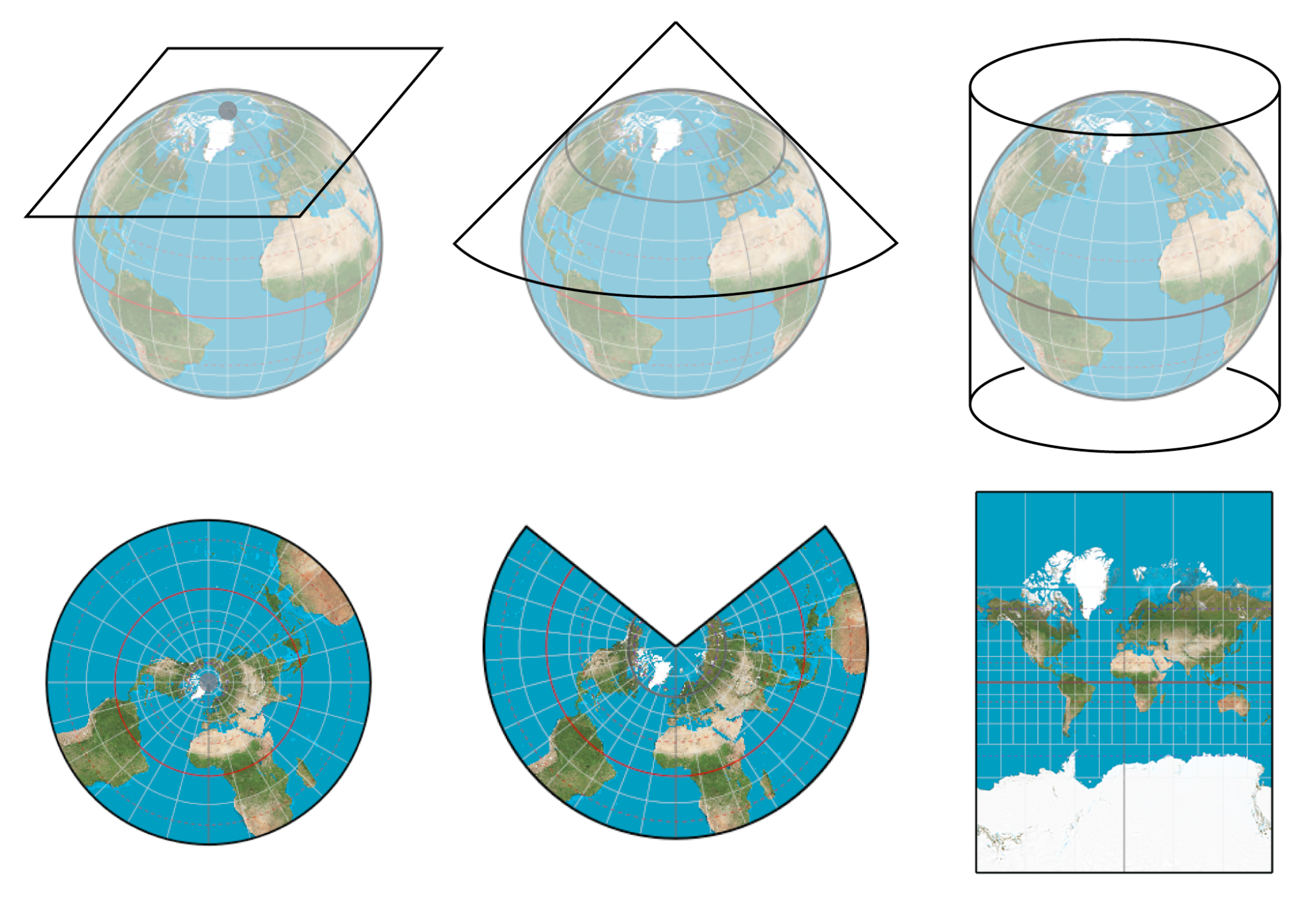
Map Projections
Projections converts spherical co-ordinates (longitude/latitude) on to planar co-ordinates.
Three common types projections:
  Azimuthal Equidistant Projection( e.g. Mercator projection)
  Central Cylindrical Projection( e.g. Robinson projection)
  Equidistant Conic Projection ( e.g. Lambert conformal conic projection)
All projection have limitations and distortions

Slide 20
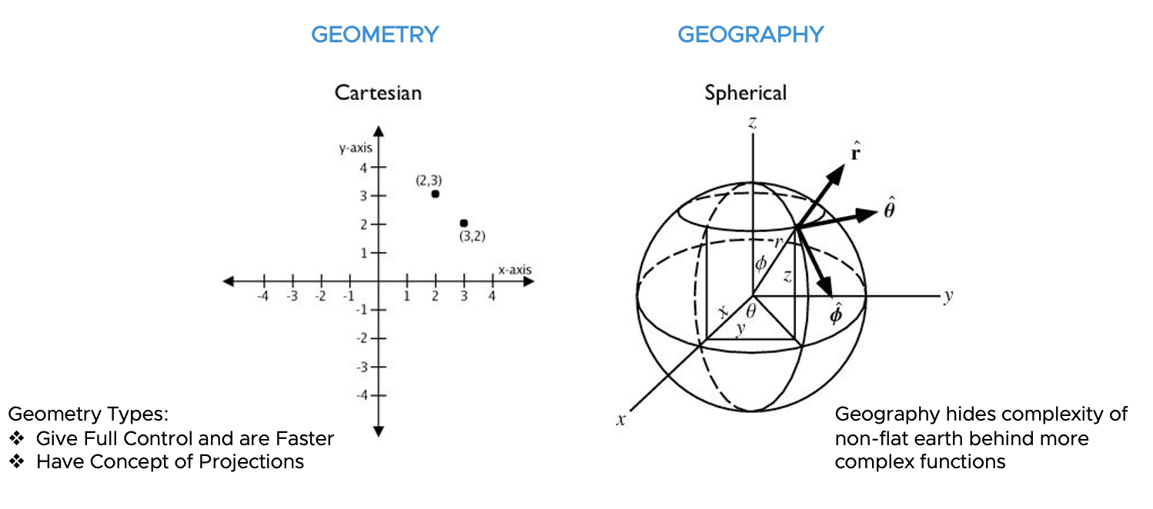
Postgis Data Types
Geometry: The type representing spatial features with planar coordinate systems.
Geography: The type representing spatial features with geodetic (ellipsoidal) coordinate systems.
Notes:
Geoemtry data:
points, lines shapes
Geography: data in long lat coordinates , slower

Slide 21
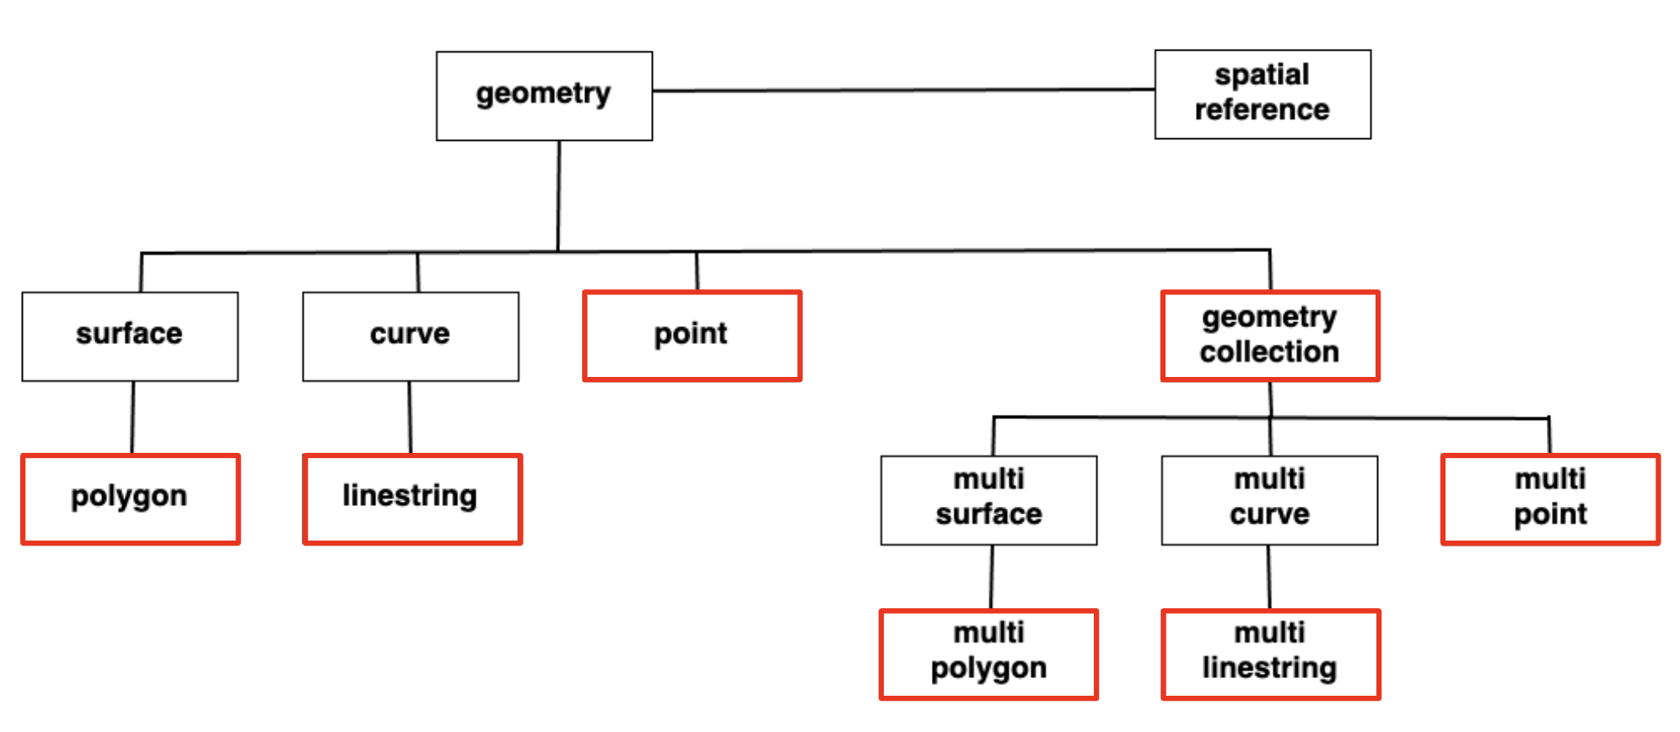

PostGIS Spatial Data Types
Data Types
POINTS
LINESTRING
POLYGON
MULTIPOINT
MULTILINESTRING
MULTIPOLYGON
GEOMETRYCOLLECTION

Slide 22
PostGIS
SELECT ST_Distance(
-- Los Angeles (LAX)
'SRID=4326;POINT(-118.4079 33.9434)'::geometry,
-- Paris (CDG)
'SRID=4326;POINT(2.5559 49.0083)'::geometry
);
st_distance
--------------------
121.89828597010705
(1 row)
Greenplum Time: 8.054 ms
Postgres Time: 17.900 ms
SELECT ST_Distance(
-- Los Angeles (LAX)
'SRID=4326;POINT(-118.4079 33.9434)'::geography,
-- Paris (CDG)
'SRID=4326;POINT(2.5559 49.0083)'::geography
);
st_distance
------------------
9124665.27317673
(1 row)
Greenplum Time: 75.738 ms
Postgres Time: 118.900 ms
Notes:
Geoemtry data:
points, lines shapes
Geography: data in long lat coordinates , slower

Slide 23
PostGIS
Geography - Casting
CREATE TABLE nyc_subway_stations_geog AS
SELECT
ST_Transform(geom, 4326)::geography AS geog,
name,
routes
FROM nyc_subway_stations;

Slide 24
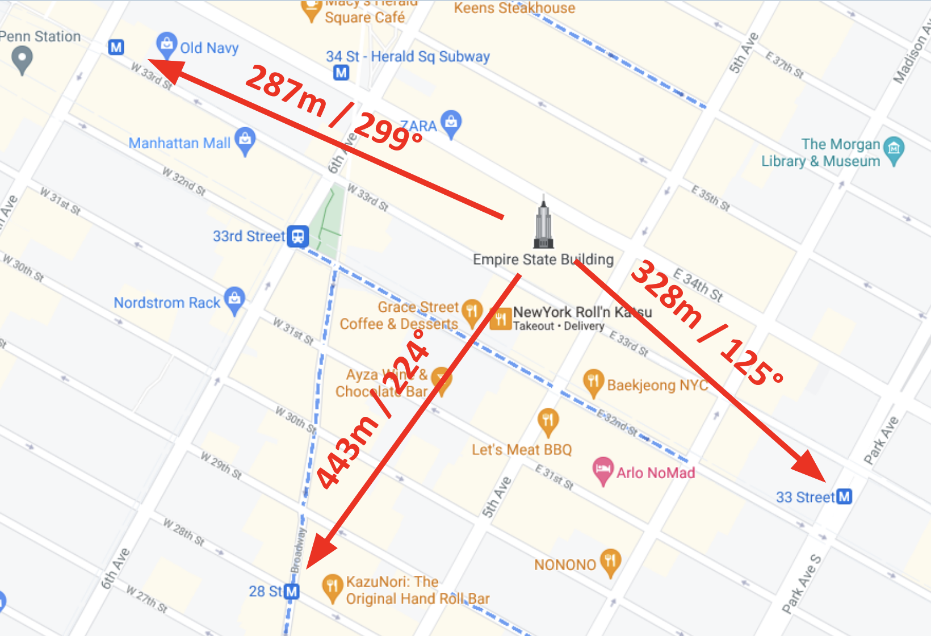
PostGIS
Find subway station near emp state building
WITH empire_state_building AS (
SELECT 'POINT(-73.98501 40.74812)'::geography AS geog)
SELECT name,
ST_Distance(esb.geog, ss.geog) AS distance,
degrees(ST_Azimuth(esb.geog, ss.geog)) AS direction
FROM nyc_subway_stations_geog ss,
empire_state_building esb
WHERE ST_DWithin(ss.geog, esb.geog, 500);
name | distance | direction
---------+--------------+--------------------
34th St | 287.81392612 | 299.1692334296477
33rd St | 328.69892475 | 125.32941042373947
28th St | 443.96653545 | 224.97916574838055
(3 rows)
Greenplum Time: 139.065 ms
Postgres Time: 744.200 ms

Slide 25
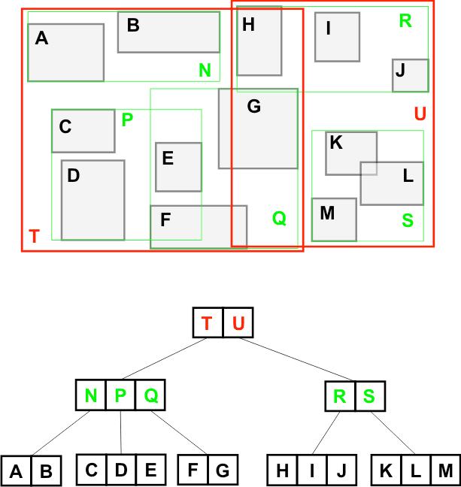

Spatial Indexing - generic index structure( GIST)
Spatial indexing accelerates the retrieval of data by narrowing down the search space during spatial queries..
R-Trees break up data into rectangles, and sub-rectangles, and sub-sub rectangles, etc.
This R-Tree organizes the spatial objects so that a spatial search is a quick walk through the tree.
To find what object contains. ?
  The system first checks if it is in T or U (T)
  Then it checks if it is in N, P or Q (P)
  Then it checks if it is in C, D or E (D)
Only 8 boxes have to be tested. A full table scan would require all 13 boxes to be tested. The larger the table, the more powerful the index is.
Notes:
spatial index is one of the three key features of a spatial database.
Standard database indexes create a hierarchical tree based on the values of the column being indexed. Spatial indexes are a little different – they are unable to index the geometric features themselves and instead index the bounding boxes of the features.
“R-Tree” spatial index structure.
Most of the commonly used functions in PostGIS (ST_Contains, ST_Intersects, ST_DWithin, etc) include an index filter automatically. But some functions (e.g., ST_Relate) do not include an index filter.

Slide 26
Spatial Indexing - generic index structure( GIST)
CREATE INDEX nyc_subway_stations_geog_gix
ON nyc_subway_stations_geog
USING GIST (geog);
WITH empire_state_building AS (
SELECT 'POINT(-73.98501 40.74812)'::geography AS geog
)
SELECT name,
ST_Distance(esb.geog, ss.geog) AS distance,
degrees(ST_Azimuth(esb.geog, ss.geog)) AS direction
FROM nyc_subway_stations_geog ss,
empire_state_building esb
WHERE ST_DWithin(ss.geog, esb.geog, 500);
Greenplum Time: 22.347 ms
Postgres Time: 182.100 ms
Notes:
spatial index is one of the three key features of a spatial database.
Standard database indexes create a hierarchical tree based on the values of the column being indexed. Spatial indexes are a little different – they are unable to index the geometric features themselves and instead index the bounding boxes of the features.
“R-Tree” spatial index structure.
Most of the commonly used functions in PostGIS (ST_Contains, ST_Intersects, ST_DWithin, etc) include an index filter automatically. But some functions (e.g., ST_Relate) do not include an index filter.

Slide 27
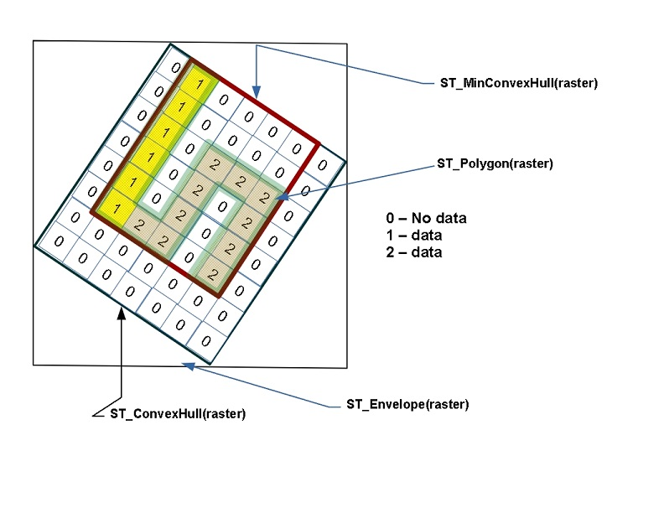
PostGIS Raster (postgis_raster)
PostGIS supports another kind of spatial data type called a raster.
Raster data is represented as an n-dimensional matrix consisting of pixels and bands.
Each pixel stores a value corresponding to each band
Raster’s can interact with geometries.
Many operations applied to rasters will result in geometries.
Notes:
Common ones the ST_Polygon, ST_Envelope and ST_ConvexHull.

Slide 28
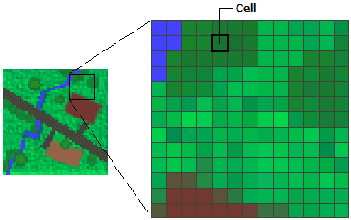
PostGIS Raster (postgis_raster)
Few use case of raster data
Environmental monitoring and analysis, e.g., monitoring land use changes, vegetation analysis, or water quality assessment.
Terrain modeling, slope analysis, and elevation-based studies.
Urban planning and infrastructure development.
Disaster management and risk assessment.

Slide 29

H3
by uber

Slide 30

H3 Introduction
H3 is an open-source geospatial indexing system that partitions the world into hexagonal cells.
H3 is a hierarchical grid system designed to efficiently index and organize geospatial data.
The H3 grid system offers advantages such as spatial indexing, fast neighbour searches, and efficient spatial aggregation.
The H3 library provides APl’s and tools for binding with different programming languages.
H3 uses Dymaxion map. Projection to map the world before creating indexes.
The hierarchical nature of the grid enables efficient data aggregation.

Slide 31
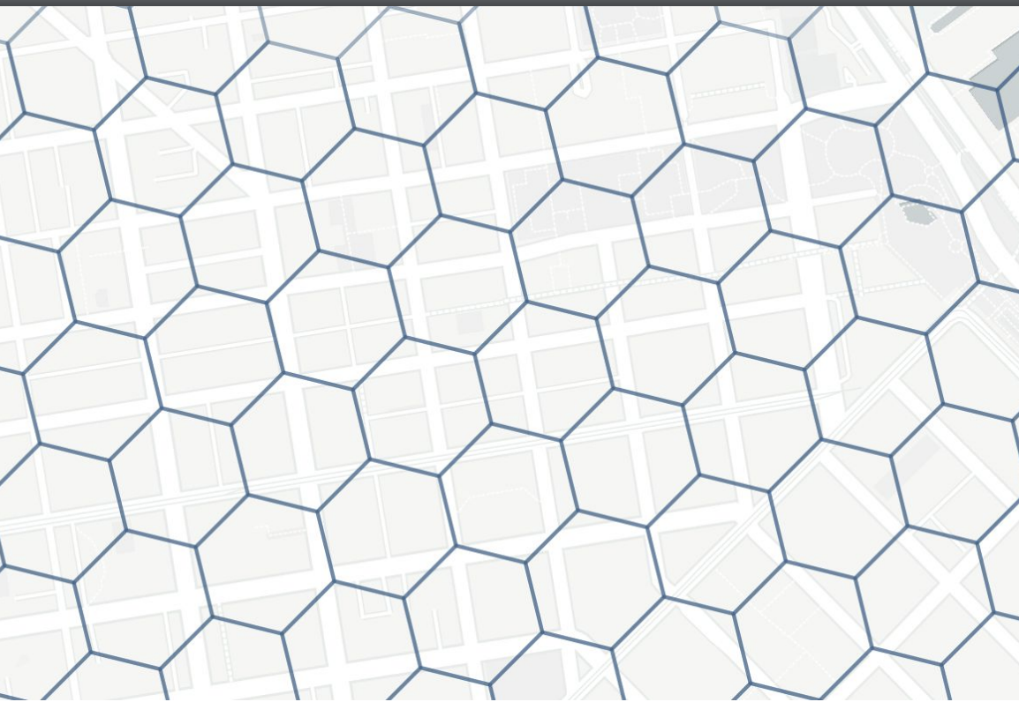
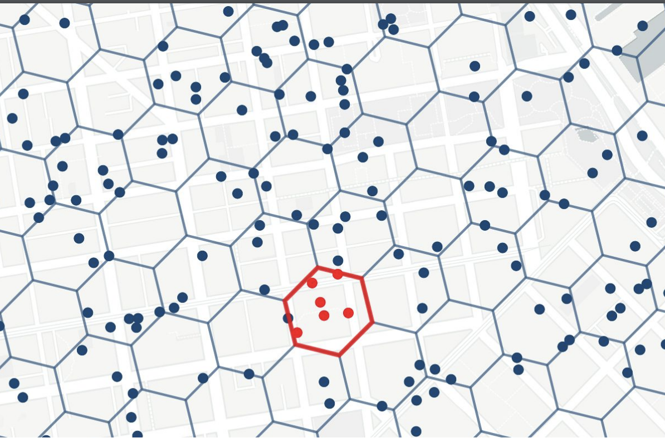
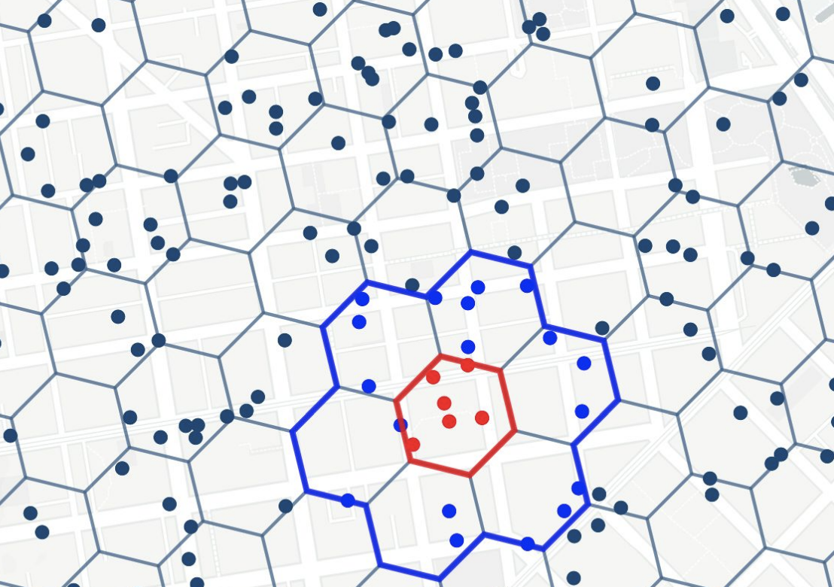
H3
Partition
Index
Run Algo

Slide 32
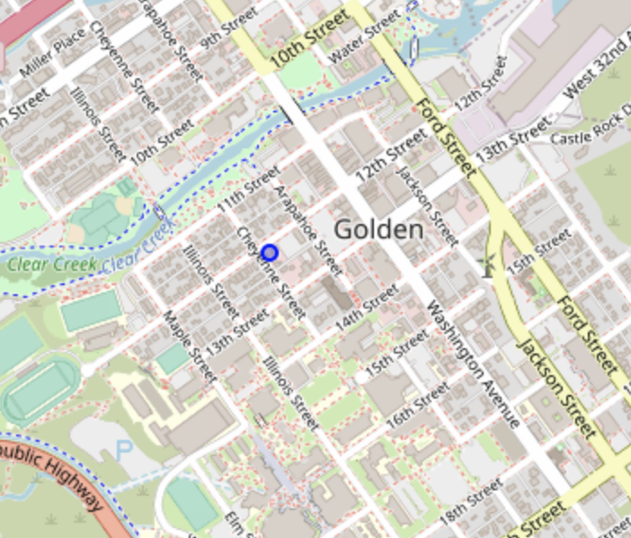
H3
index
ALTER TABLE osm.building_polygon ADD h3_ix H3INDEX
GENERATED ALWAYS AS ( h3_lat_lng_to_cell(ST_Transform(ST_Centroid(geom), 4326), 7) )
STORED ;
CREATE INDEX gix_building_polygon_h3_ix ON osm.building_polygon (h3_ix);
SELECT osm_id, name, h3_ix, geom FROM osm.building_polygon WHERE osm_id = 392853178 ;
osm_id │ name h3_ix
392853178 │ Pangea Coffee Roasters │ 872681364ffffff

Slide 33
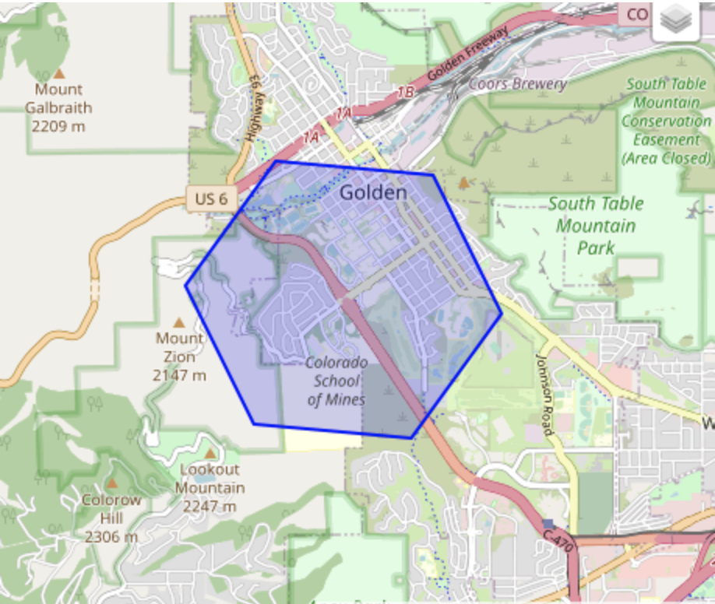
H3
Boundary
The query above returned the h3_ix value (872681364ffffff) for the resolution 7 hex.
We can see the polygon of the hex using the h3_to_geo_boundary_geometry()
SELECT h3_cell_to_boundary_geometry('872681364ffffff');

Slide 34
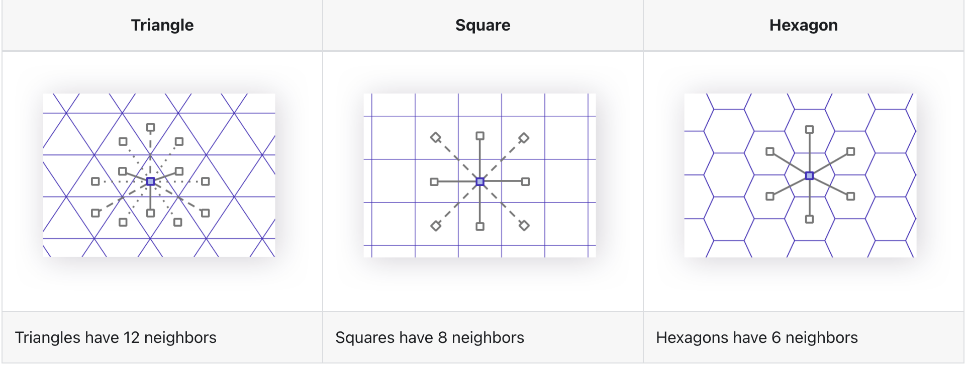
H3
Why Hexagon?
Advantages:
Uniform edge length
Uniform angles
Optimally compact
Optimally space-filling
Uniform adjacency
Hierarchical relationships
Low shape distortion
Low area distortion
Trade-offs:
Not completely uniform shape
Not perfect child containment

Slide 35
H3
Postgis vs H3
find trees within 10 kilometers from the focus point
SELECT b.osm_id, b.name, b.height, n.geom
FROM osm.building_polygon b
INNER JOIN osm.natural_point n
ON n.osm_type = 'tree' AND ST_DWithin(b.geom, n.geom, 10000) WHERE b.osm_id = 392853178 ;
Postgis Time: 14 - 25 ms
Returns: 12,000 rows
WITH rng AS
( SELECT h3_grid_disc(h3_ix, 3) AS ix_ring
FROM osm.building_polygon b WHERE b.osm_id = 392853178
)
SELECT * FROM rng b INNER JOIN osm.natural_point n
ON n.osm_type = 'tree’
AND n.h3_ix = b.ix_ring ;
H3 Time: 4 - 6 ms.
Returns: 12000 rows
Notes:
WITH ordered_nearest AS (
SELECT
ST_GeometryN(str.geom,1) AS streets_geom,
str.gid AS str_gid,
sub.geom AS subways_geom,
sub.gid AS subways_gid,
ST_Distance(str.geom, sub.geom) AS distance
FROM nyc_streets str
JOIN nyc_subway_stations sub
ON ST_DWithin(str.geom, sub.geom, 200)
ORDER BY subways_gid, distance ASC
)

Slide 36
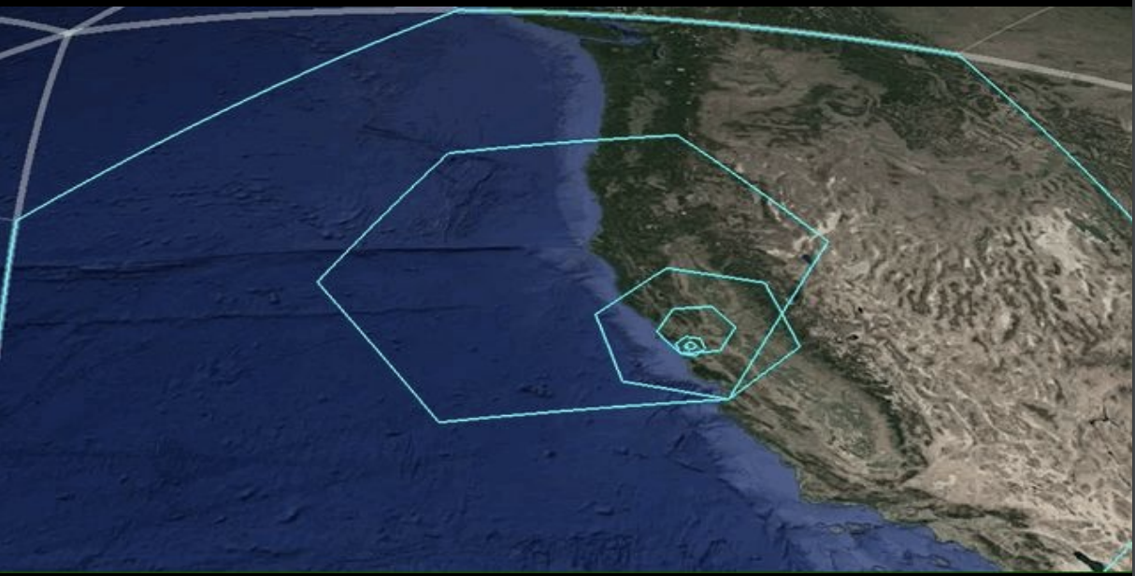
H3
Resolutions
Hierarchical subdivisions:
With the largest resolution roughly the size of continents down to the smallest resolution of a meter squared. The library gives flexibility in the size of hexagon to work with

Slide 37
H3
Resolution
SELECT i, h3_get_num_cells(i) FROM generate_series(0, 15, 3) I ;
i | h3_get_num_cells
----+------------------
0 | 122
3 | 41162
6 | 14117882
9 | 4842432842
12 | 1660954464122
15 | 569707381193162

Slide 38
Future Extension
3dcitydb
pgPointcloud

Slide 39
Sources
https://www.youtube.com/@UberEngineering
https://h3geo.org/docs/
https://www.youtube.com/@CrunchyDataPostgres
https://postgis.net/
https://postgis.net/workshops/postgis-intro/
https://blog.rustprooflabs.com/
https://www.youtube.com/@greenplum
https://greenplum.org/tutorials/

