Slide 1
How Unused Index, Fragmentation and Idle Connection Can Slow Down DB Performance
Veerendra Pulapa - Technical Consultant

Slide 2
About Me
Name: Veerendra Pulapa
Current Position: Technical Consultant at Ashnik
Education: Bachelor Degree, JNTUH
Relevant Experience:
6+ years of experience in database administration and its implementation
Proficient in SQL and NOSQL
Expertise in database design, implementation, performance tuning and optimization
Certifications: PostgreSQL & YugaByte Certified Professional
Professional Achievements:
Reduced database downtime by 50% through implementation of automated monitoring and alerting tools(My Postgres)
Designed and implemented a disaster recovery plan that reduced data loss from hours to minutes in the event of a system failure

Slide 3
About us
A leading open source technology partner for the digital-first era
Since inception in 2009, enabled over 200 leading enterprises across SE Asia & India Enabling the adoption of right-fit open source solution and technologies
End-to-end digital transformation specialists - Consultation, Services, Support & Training
Cross industry experience in BFSI, Telco, Govt, Retail, E-commerce and more

Slide 4
What is Our Role?

Slide 5
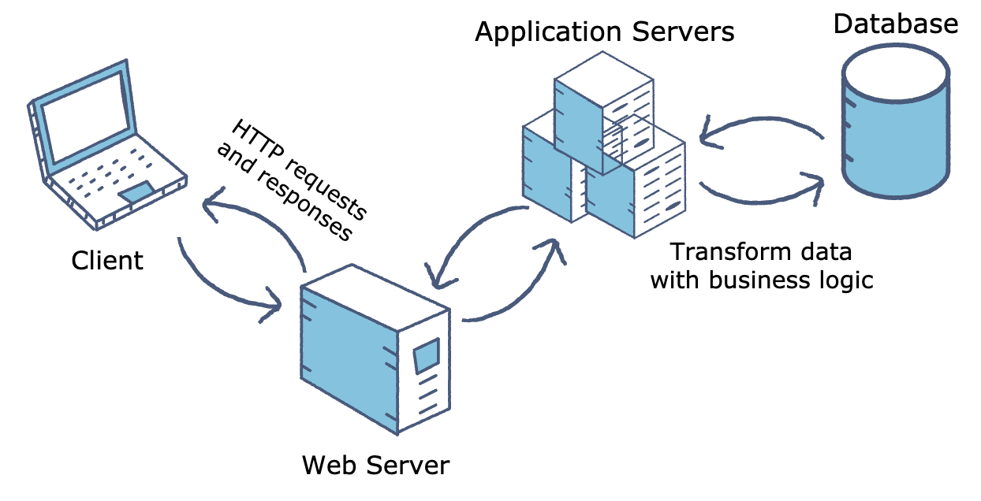
Database Server
Dealing with large amount of data.
Providing concurrent access control.
Storing applications and non-database files.
Central management of data

Slide 6
Database Center Of Attention
Everyone always pointing at database First.
(Apps crash, Apps slow, Apps not accessible).
Database is vital object for the production availability.
Data is the new gold.

Slide 7
Maintain your database performance
Database maintenance is a highly neglected topic in daily PostgreSQL operation.
Common understanding that database performance maintenance need to be done regularly and essentially. (only a few users are aware of the extra work that goes into it)
Database maintenance works is rarely come out due to the lack of in-depth knowledge of SQL itself, and not able to carry out the tasks with efficient timelines.
Notes:
Database maintenance is a highly neglected topic in daily PostgreSQL operation. While it is a common understanding that database backups need to be done regularly and essentially, only a few users are aware of the extra work that goes into it. One of the main reasons, you don’t see many database maintenance works is the lack of in-depth knowledge of SQL itself, and being able to carry out the tasks with efficient timelines. At times, a database maintenance not done properly may go unnoticed, but when the database performance is hit; is when it turns into a real issue.

Slide 8
Don’t Neglect Routine Maintenance
Vacuum in PostgreSQL to prevent dead tuple or wrap around situation.
PostgreSQL Visibility and current statistic refresh.
Automatic vacuum and analyze Postgres.
Reindexing index.
Database Log monitoring
Notes:
1: Vacuum is processed in PostgreSQL, which does a clean-up job of dead rows or dead tuples. It is like the defragmentation activity of dead rows/tuples or commonly known as bloat.
2: PostgreSQL maintains the old tuples versioning for visibility in a transaction via MVCC. Hence, it will not remove immediately, and due to the MVCC functionality, it keeps those versions of data unless someone tells it to remove them.
3: There is an automatic vacuum process in PostgreSQL, but many times for specific load, DBA prefers to schedule this for better performance.
4: If someone does not vacuum frequently, then database performance will go down as versions of data tuples increase. In fact, after a few days/months, it may crash due to transaction wraparound.

Slide 9
Any other reason that brings down PostgreSQL performance?

Slide 10
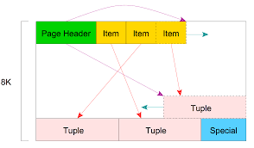
Fragmentation
Fragmentation allow user to control where data is stored at table level.
When a block of data is being read in Postgres by one transaction, a second transaction may be in the process of updating or deleting it.
These deletes and updates accumulate as many dead tuples. This collection of dead tuples is what we refer to as “bloat”.
Large amount of dead tuple will be degrade the performance.

Slide 11
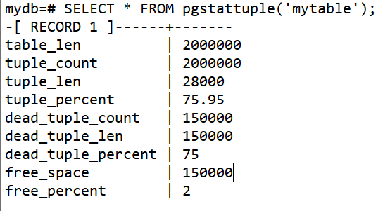
How to identify and control?
Pgstattuple extension
CREATE EXTENSION pgstattuple;
Select pgstattuple(<table>);
Sample output:

Slide 12
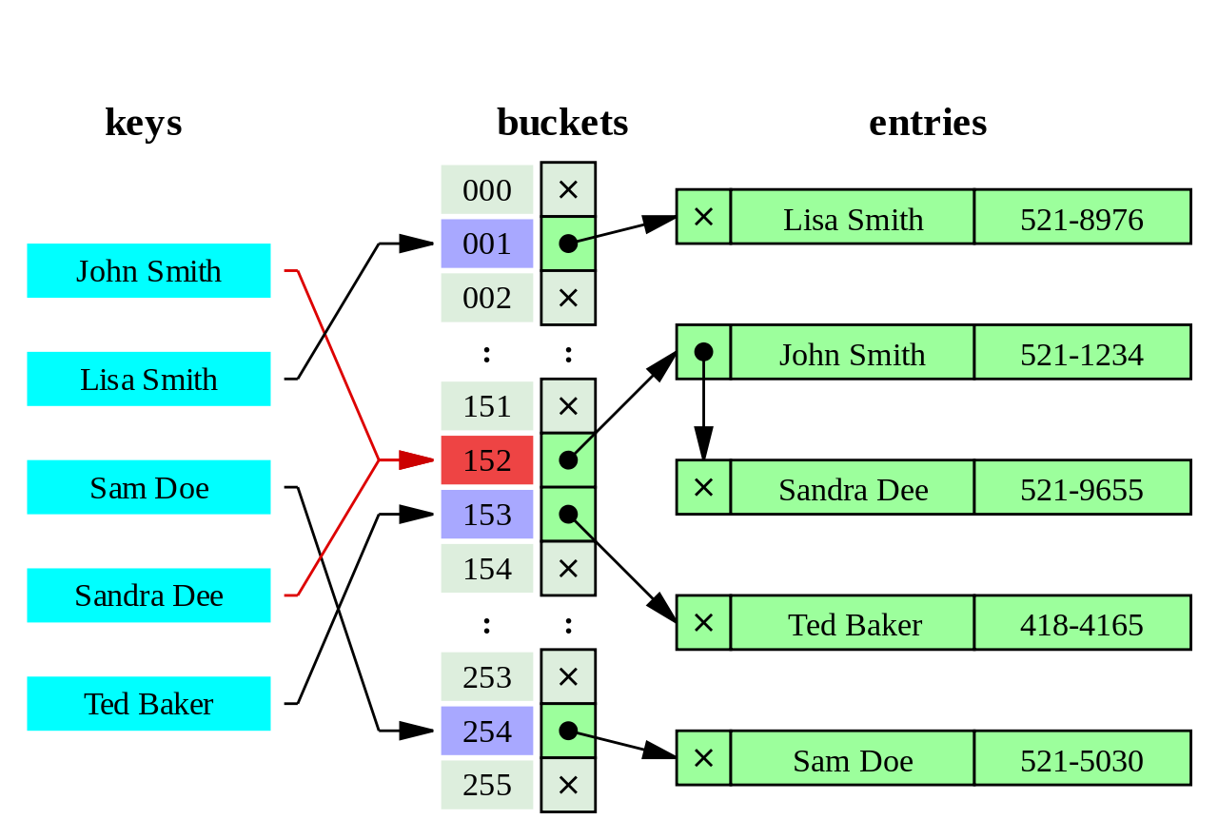
Unused Index
Index are not always useful.
Are you sure index increase your data retrieval process?
Consider deleted unused index.

Slide 13
What?
Increased write time
Increased query time
Increased maintenance overhead
Increased disk space usage
How?
Pg_stat_user_indexes
SELECT schemaname, relname, indexrelname, idx_scan, idx_tup_read, idx_tup_fetch
FROM pg_stat_user_indexes
WHERE idx_scan = 0;
Monitor performance metrics
Analyze query plans

Slide 14
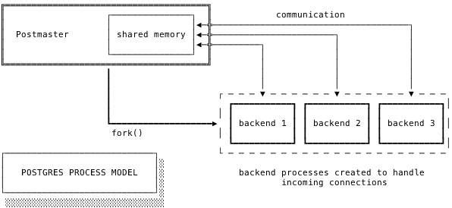
Idle Connection
Connection established between process
Session looks for the required page in its own shared buffers.
If it can’t find the page in shared buffers, it fetches the page from the operating system (OS) cache
As the count of the PostgreSQL connections increases, the free memory available for the OS cache goes down.
If the instance is low on free memory, it starts using the swap space, which is again on the storage volume and therefore slow.

Slide 15
How and what?
Connection Pooling
Long-Running Queries
Session Management

Slide 16
Recomdentation
Optimize queries
Indexing
Vacuum and Analyze
Increase memory
Configure PostgreSQL
Upgrade hardware
Use partitioning
Use connection pooling
Use a caching layer
Use a content delivery network (CDN)
Use a query cache
Monitor and optimize your PostgreSQL configuration

