Slide 1
Full Text Search in PostgreSQL
Vaijayanti Bharadwaj

Slide 2
About Me
20+ years of experience designing and architecting enterprise products in storage, file systems, secondary storage, distributed systems and database storage engines
Author of a book: “Database Transactions and Concurrency Control: Isolation Levels
and MVCC Demystified”

Slide 3
Uses of Full Text Search
Analytics
Many fields can be descriptive, requiring full text indexing and searches
Anomaly detection
Detecting anomalous patterns has become important for purposes such as ransomware detection or security attacks
Finding similar documents
Purposes such as E-discovery, compliance require finding documents similar to given set of documents
Logging
As applications get more complex and distributed, searching logs becomes important for auditing, debuggability, alerting, etc.

Slide 4
Background
Lucene-based full text search engines very popular today, notably Elasticsearch and Solr
Engines like Elasticsearch encourage use of a denormalized data model
Many-one or one-many relationships are handled by nesting objects
Many-many relationships are handled at the application level
Engines such as Elasticsearch do not give full ACID semantics
Concurrent Updates – can cause failures, give different behavior based on how they are done
Application has to be aware to make sure they happen correctly
Atomicity – is at a record level
Idempotency – has to be taken care of at application level, such as undoing or redoing the results of half inserted batches

Slide 5
Databases for Full Text Search (FTS)
A separate datastore such as Elasticsearch needs to be maintained actively
Consistency of data between database and the search datastore needs to be considered
Inconsistent view – mixing old and new data
Dangling pointers
Stale data, etc
SQL supports powerful queries, when the terms to be searched for are known precisely. A combination of FTS in conjunction with SQL is very useful - (FTS + Temporal + Spatial + Graph)
Databases support many-many relationships, joins and when used with FTS, this makes the searches very useful
Full ACID semantics
Ability for different users to see different search results

Slide 6
Goal
Look at PostgreSQL Full Text Capabilities as applied to a real-life Wikipedia dataset
Comparison of Indexing performance
Comparison of Search performance
qualitative (features) and quantitative (latencies)
Extent to which PostgreSQL takes us out-of-the-box
Limitations of PostgreSQL
Conclusion and Recommendations

Slide 7
Introduction to Full Text Search

Slide 8
Key Features of Full Text Search
Support provided by operators like LIKE, ILIKE, ~~, ~, ~* is not sufficient
Ability to search different forms of words, based on the language such as “story” can be same as “stories”, so is “jump” and “jumped”
Removal of punctuation marks, irrelevant words (stop words) such as “a”, “an” ,”the” etc
Accounting for synonyms, depending on the domain and language
Ranking of results based on the “extent” to which they matched
Ability to speed up searches by indexing, rather than full table scans
Ability to boost one or more fields during the search

Slide 9
Entities in Full Text Search
Document – equivalent to a row
Can have precisely searchable fields (type: “keyword”) and full-text search ones (type: “text”)
Tokens – Parsers break down each document into tokens
Different tokenizers for say words, numbers, file paths, URLs, etc
Lexemes - Dictionaries process each token to create an array of sorted lexemes that retains position information and information on the column it was found
Dictionary and Parsers are language specific

Slide 10
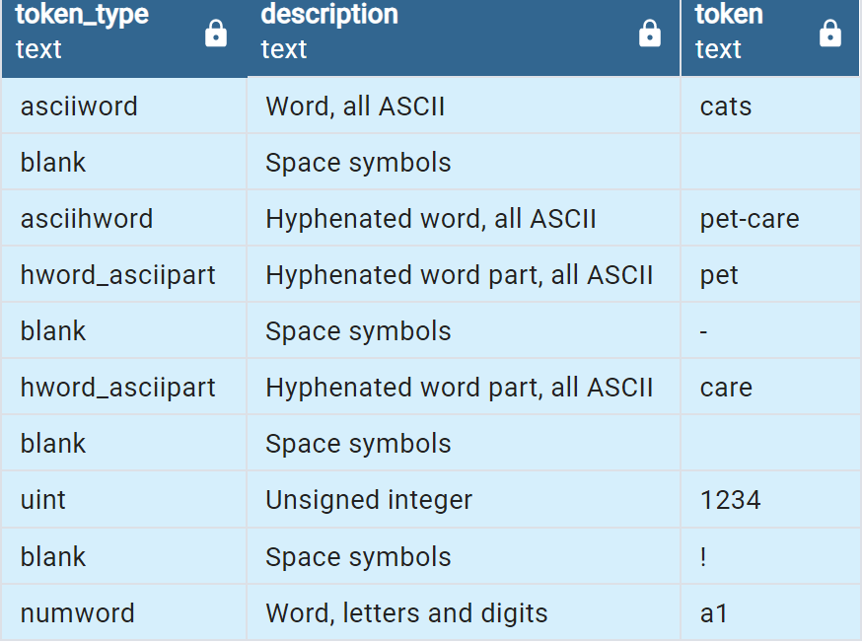
Tokenization SELECT t.tokid, tt.alias AS token_type, tt.description, t.token FROM (SELECT (ts_parse('default', 'cats pet-care 1234 ! a1')).*) AS t JOIN ts_token_type('default') tt ON t.tokid = tt.tokid;

Slide 11
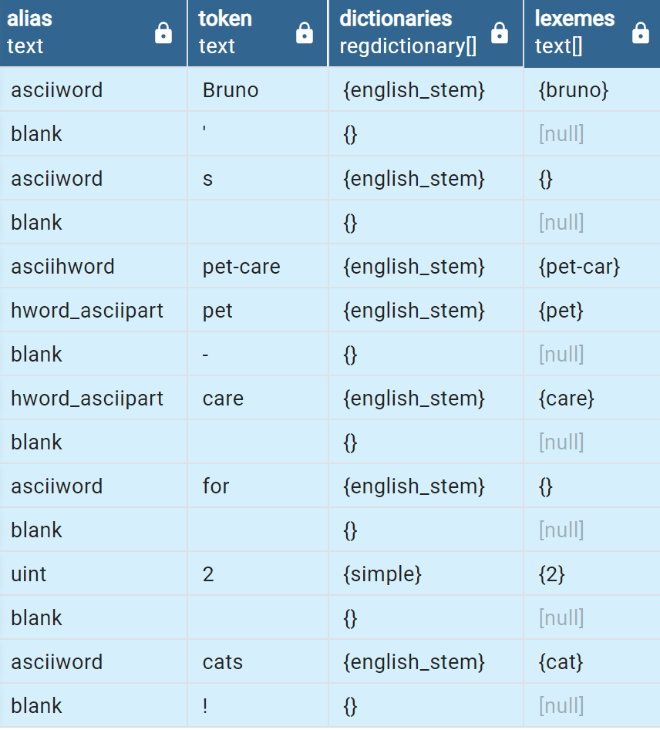
Lexemes SELECT alias AS token_type, token, dictionaries, lexemes FROM ts_debug('english', 'Bruno''s pet-care for 2 cats!');

Slide 12
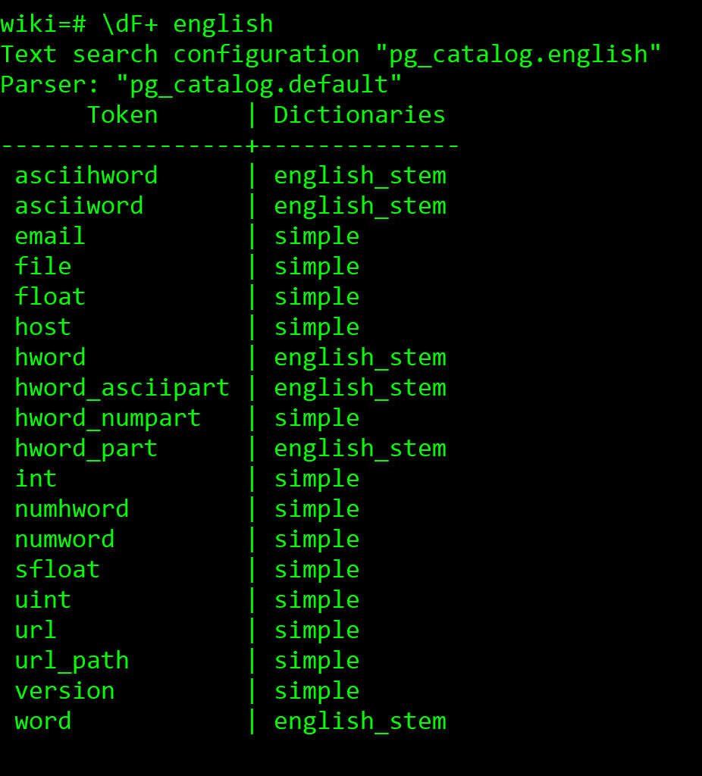
Default Dictionary Configuration

Slide 13
Full Text Tools
tsvector: Array of lexemes with positional information sorted in order of lexemes
tsquery: A full text query with Boolean operators & I !
to_tsvector(‘english’::regconfig, <text columnname>::text)
Converts the given text to tsvector
to_tsquery(‘english’::regconfig, ‘<query>’ ::tsquery)
Converts the query into a query tree
tsvector @@ tsquery: Does this tsvector match the tsquery?

Slide 14
Examples: Converting text to tsvector
SELECT to_tsvector('english', 'Bruno''s pet-care for 2 cats!’);
to_tsvector
------------------------------------
“ '2':7 'bruno':1 'care':5 'cat':8 'pet':4 'pet-car’:3 ” token:position
SELECT to_tsvector(‘hello world’) @@ to_tsquery(‘hello & world’);
?column?
----------------
t
(1 row)

Slide 15
Experiment

Slide 16
Schema
CREATE TABLE wikidocs(
id INT PRIMARY KEY,
ns INT,
contributor VARCHAR(255),
ts TIMESTAMP WITH TIME ZONE,
titles TEXT,
content TEXT);
CREATE INDEX fts_idx ON wikidocs USING GIN(
setweight(to_tsvector(‘simple’, titles), 'A') ||
setweight(to_tsvector(‘english’, content), 'B'));

Slide 17
Schema
CREATE TABLE wikidocs(
id INT PRIMARY KEY,
ns INT,
contributor VARCHAR(255),
ts TIMESTAMP WITH TIME ZONE,
titles TEXT,
content TEXT,
fts TSVECTOR GENERATED ALWAYS
AS(setweight(to_tsvector('simple’, titles), 'A') ||
setweight(to_tsvector('english’, content), 'B’))
STORED);
CREATE INDEX fts_idx ON wikidocs USING GIN (fts);

Slide 18
ts_query example
Find all relevant documents which discuss US nuclear policy
WITH query AS (SELECT to_tsquery
('(US | USA | United <-> States |
(United <-> States <2> America)) & (nuclear <-> policy)’) AS q)
SELECT titles, ts_rank(fts, query.q) AS rank, ts_headline(content, query.q)
FROM wikidocs, query
WHERE fts @@ query.q ORDER BY rank DESC;

Slide 19
Examples: tsquery

Slide 20
Elasticsearch Schema
"contributor_id" : {
"type" : "keyword"
},
"doctext" : {
"type" : "text"
},
"titles" : {
"type" : "text"
},
"ns" : {
"type" : "integer"
},
"ts" : {
"type" : "date"
}
Keyword type means enable it for precise searches
These types are not analyzed, stored and searched as they are
Text is “analyzed” to allow for inexact searches
If not specified, Standard Analyzer is the default

Slide 21
Comparison

Slide 22
Indexing
Metrics (average) | PG with GIN (inline) | PG with GIN (offline indexing) | Elastic
Time Taken(s) | 2440 | 1885 | 1007
CPU % | 49% | 55% | 95%
Write MB/s | 118 | 34.4 | 55
Read MB/s | 34 | 13.3 | 16
Disk Utilization | 29 | 19 | 50
Disk writes/s | 2586 | 240 | 450
Disk reads/s | 227 | 390 | 100
Index Size GB (Data+Index) | 29 (15+14) | 18.9 (15+3.9) | 9.23
PostgreSQL 15
8 parallel processes
8 vCPUs
32 GiB memory
Toshiba NVMe
11.7 million docs

Slide 23
Search
Metrics (average) | PostgreSQL | Elastic
Queries per second | 37 | 421
CPU % | 100 | 100
Write MBps | 1.5 | .06
Read MBps | 60 | 50
Disk Utilization % | 55 | 30
Disk writes/s | 150 | 21
Disk reads/s | 5500 | 2300
Database Size (GB) | 29 | 9.25
64 processes,
10000 queries each
PostgreSQL 15
8 parallel processes
8 cores
32 GiB memory
Toshiba NVMe
11.7 million docs

Slide 24
Comparison with RUM: Indexing
Metrics (average) | PG with GIN (inline) | PG with RUM (inline indexing) | Elastic
Time Taken(s) | 3889 | 9301 | 540
CPU % | 9.5 | 14 | 57
Write MBps | 82 | 69 | 80
Read MBps | 9.3 | .04 | 10
Disk Utilization | 74 | 98 | 81
Disk writes/s | 1865 | 311 | 250
Disk reads/s | 184 | 3 | 80
Index Size GB (Data+Index) | 29 | 23.5 | 9.25
8 parallel processes,
Azure Ubuntu VM
8 vCPUs
16 GiB memory
Premium SSD LRS,
Max 100 MBps
11.7 million docs

Slide 25
Comparison with RUM: Search
Metrics (average) | GIN | RUM | Elastic
Queries per second | 14 | 76 | 345
CPU % | 17 | 57.4 | 93
Write MBps | 0.4 | .5 | 0
Read MBps | 285 | 293 | 69
Disk Utilization % | 99 | 97 | 92
Disk writes/s | 4 | 30 | 0
Disk reads/s | 32178 | 31691 | 2150
64 parallel processes
1000 queries each
Azure Ubuntu VM
8 vCPUs
16 GiB memory
Premium SSD LRS,
Max 100 MBps
11.7 million docs

Slide 26
Qualitative Comparison
Query | PostgreSQL | Elastic
&, !, |, precedence | Yes | Yes
Phrase | Yes | Yes
Slop of N | Yes, supports exact N only | Yes, 1 to N
Synonym | By adding external dictionaries | yes out-of-the-box
Comes after | No | Yes
Highlighting | Yes, with some limits | Yes
Aggregations, Sorting | Yes | Yes
Customizability | Full | Out-of-the-box capabilities usually sufficient Customization is not well-documented
Inferred Schema | No | Yes

Slide 27
Query Comparison between GIN and RUM with data in memory
Search for documents with these adjacent terms
‘ nuclear <-> policy'

Slide 28
GIN RUM
Sort (cost=655.93..656.30 rows=148 width=37) (actual time=29.659..29.666 rows=72 loops=1)
Sort Key: (ts_rank(fts, '''nuclear'' <-> ''polici'''::tsquery)) DESC
Sort Method: quicksort Memory: 30kB
-> Bitmap Heap Scan on wikidocs (cost=61.15..650.60 rows=148 width=37) (actual time=4.414..29.612 rows=72 loops=1)
Recheck Cond: (fts @@ '''nuclear'' <-> ''polici'''::tsquery)
Rows Removed by Index Recheck: 1503
Heap Blocks: exact=1558
-> Bitmap Index Scan on fts_idx (cost=0.00..61.11 rows=148 width=0) (actual time=3.760..3.761 rows=1575 loops=1)
Index Cond: (fts @@ '''nuclear'' <-> ''polici'''::tsquery)
Planning Time: 0.188 ms
Execution Time: 29.699 ms
Sort (cost=631.73..632.07 rows=139 width=38) (actual time=20.951..20.955 rows=72 loops=1)
Sort Key: (ts_rank(fts, '''nuclear'' <-> ''polici'''::tsquery)) DESC
Sort Method: quicksort Memory: 30kB
-> Index Scan using fts_idx1 on wikidocs1 (cost=64.00..626.78 rows=139 width=38) (actual time=20.396..20.920 rows=72 loops=1)
Index Cond: (fts @@ '''nuclear'' <-> ''polici'''::tsquery)
Planning Time: 0.185 ms
Execution Time: 20.984 ms

Slide 29
Observations
Elasticsearch indexing and search is definitely superior and benefits from these:
Elasticsearch has extremely compact indexes due to conversion of all strings – row ids to doc ids, lexemes or terms to term ids and using run length encoding to encode these
Use of incremental docids enable rapid traversal of posting lists
Elasticsearch’s LSM tree indexes amortize cost of inserts by batching and doing periodic compaction
LSM trees with their immutability cause less contention with parallel inserts

Slide 30
Observations
In GIN and RUM indexes, B+ trees are used for keys and postings lists
Indexes are large in size, much bigger than the data itself.
The difference in performance is less with disks supporting higher IOPs such as NVMe SSDs but more stark on slower disks
Inserts require multiple random access lookups to find the key and then a merge of the postings lists
Even if the index gets cached in memory, searches require multiple heap lookups to locate matches and perform ranking
High disk utilization is seen on slower disks, high CPU utilization on faster disks
Pending list may amortize the cost by batching inserts and sorting keys, but pending list processing is seen to be expensive and not capable of using parallelism (low CPU and disk utilization)

Slide 31
Observations
With GIN, when indexing is done after insertion of tuples, index is very compact and indexing throughput is higher by about 30%
tsvector needs to be stored as a field for non-trivial sizes of text, else searches get very slow. This bloats up the data
RUM speedens up the search 5 times compared to GIN but still about 4.5 times slower than Elasticsearch
RUM indexes are surprisingly compact as compared to GIN
When searching for highly frequent search terms, RUM is slower

Slide 32
Conclusion
PostgreSQL offers rich and well-documented customizability
PostgreSQL feature-set and language support match up to a considerable extent to an evolved engine like Elasticsearch
With JSON datatype becoming popular and a first-class column-type, full text indexing and search become very important
PostgreSQL is very well suited for OLTP and Data Warehousing scenarios, but applying it to other scenarios like full-text indexing and searching with text-heavy datasets needs considerable improvements in indexing and searching
1 MB limit for tsvector causes large documents to be truncated
Data and Index sizes needs to be compact
Indexing throughput has to be improved
Searching needs to be faster

Slide 33
Appendix

Slide 34
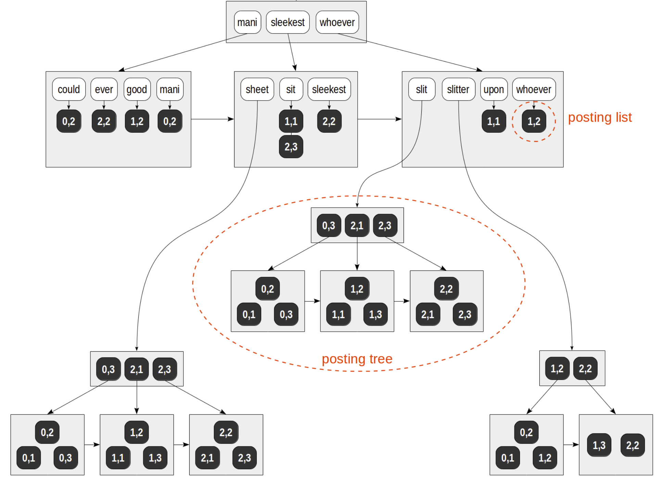
Picture: From Egor Rogov’s Blog
https://postgrespro.com/blog/pgsql/4261647

Slide 35
Thank You!

